Slide 1
Income Tax

Slide 2
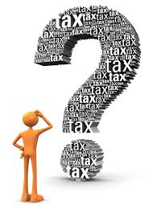
“In this world nothing can be said to be certain, except death and taxes.” Benjamin Franklin
Tax is a mandatory liability for every citizen of the country.
There are two types of tax in India
Direct Taxes are levied on taxpayers income and profits
Indirect Taxes are charged on goods and services

Slide 3










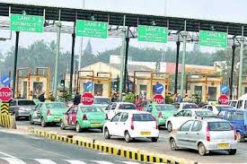


Paying tax almost everywhere!!!

Slide 4

Why should I pay tax?
I have to pay for my food, for my house, for my travel, for my medical treatment, for owning a vehicle not only cost of vehicle but also vehicle tax and what not.
Even on many roads, one has to pay toll tax! They also say that if we compare with countries like USA and UK, the people get social security as also medical facilities virtually without any cost. But India does not offer such facilities.

Slide 5
What Government Do from our TAX?
The Government provide Health care through Government hospitals (usually they offer service without any cost), Education (In Municipal and Government schools the fee is negligible).
Of course the major expenditure of Government has to be incurred on National Defense, Infrastructure Developments etc.
Taxes are used by the government for carrying out various welfare schemes including employment programs.
There are Lakhs of employees in various departments, the administrative cost has to be borne by the Government.

Slide 6
What Government Do from our TAX?
On judicial system: the Salaries, perks of Judges, Magistrates and judicial staff has also to be paid by the Government.
PM Kisan yojana: subsidy / pay-in to farmers.
The Government also provides cooking gas at concessional rate or gives subsidy.
Government also provide support to MSMEs and small business in terms of subsidies.
Thus, considering these various duties of the Government, we need to appreciate that we must pay tax as per law. We have be a responsible citizen.

Slide 7
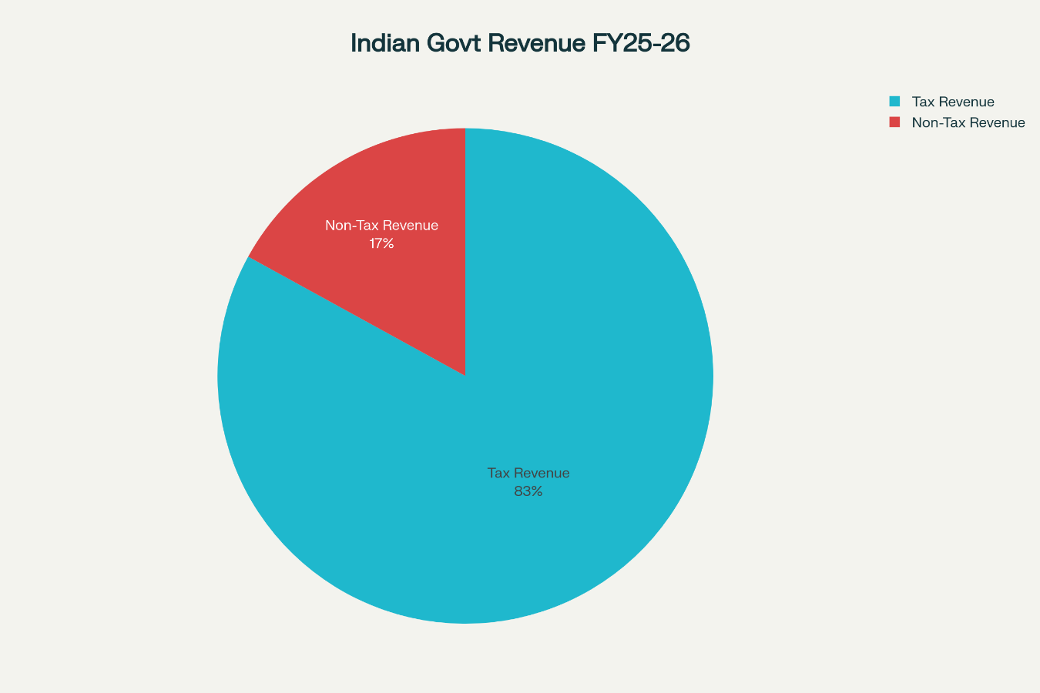
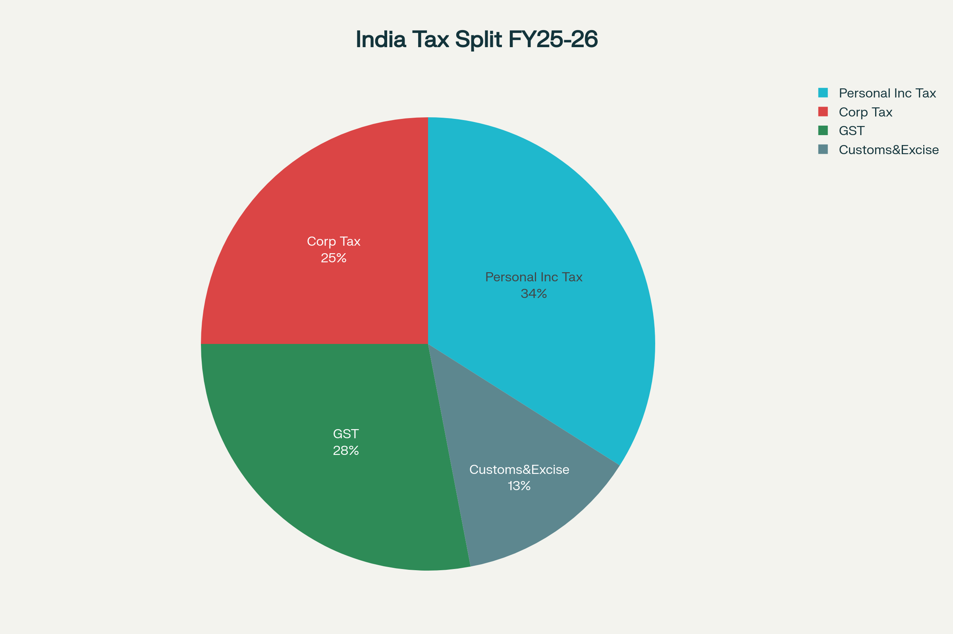

Slide 8
Tax
A fee charged (‘LEVIED’) BY A GOVERNMENT ON
INCOME
PRODUCT (OR)
ACTIVITY

Slide 9
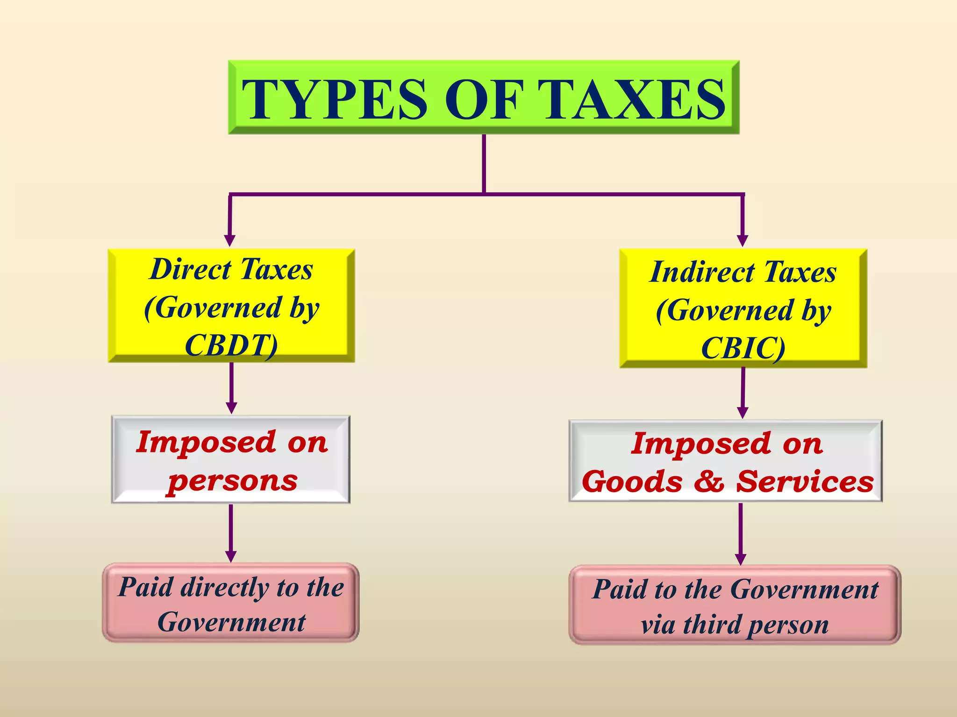

Slide 10
If tax is levied directly on the income or wealth of a person, then it is a Direct Tax.
Eg. Income tax, Wealth tax
If tax is levied on the price of a good or service, then it is called an Indirect Tax.
Eg. Excise duty, Custom duty, Service tax and Sales Tax or Value Added tax

Slide 11
Tax – Duty - Cess- Surcharge
Tax: is a payment made to the Government of a country without any return.
Duty: is a levy on goods
Cess: is a tax levied for a specific purpose.
Surcharge: is an additional tax burden to those, whose income exceeds the specified limit.
Income tax: a levy on the income earned.
Levy is not a tax- it means ‘the act of charging the tax’.

Slide 12
Duty
This is an on-border tax charged on goods (commodities or things that you can physically touch) either while coming into the country or going out of the country. Generally, a percentage of the value of the goods.
The duty that is levied for goods manufactured inside the country is called as excise duty.
Duty that is levied on goods imported from a foreign country is called as customs duty.

Slide 13
Duty vs Tax
Duty is a levy on goods
Pay the tax first and the take the goods (prior payment).
Eg: Excise duty, Custom duty.
Tax is levy on other than goods (no prior payment).
Eg: Income tax, Sales tax, Service tax.

Slide 14
Surcharge
This is an additional burden to the tax being already levied.
Generally, surcharge is levied for a certain period of time.
For instance, the surcharge being levied on super rich in India.
At present surcharge is levied-
@10% if total income exceeds Rs 50 lakhs
@15% if total income exceeds Rs 1 Crore

Slide 15
Cess
This is a tax on tax, levied by the Govt. for a specific purpose.
Generally, cess is expected to be levied till the time the Govt. gets enough money for that purpose.
The Education cess @3%, is levied currently, is meant to finance basic education in the country.

Slide 16
Why are Taxes levied?
The reason for levy of taxes is that they constitute the basic source of revenue to the government.
Revenue so raised is utilized for meeting the expenses of government like defence, provision of education, health-care, infrastructure facilities like roads, dams, public lightings, drainage etc.
The act of levying taxes is called Taxation.

Slide 17
Taxation
The persons who are taxed have to pay the taxes irrespective of any corresponding return from the goods or services by the government.
The taxes may be imposed on the income and wealth of persons or corporations, and the rate of taxes may vary.
i.e. The categories into which we can place direct and indirect taxes are called taxation.

Slide 18
Income tax
Income tax is a government charge on annual income.
It is calculated according to defined slabs and rules.
Laws and procedures are governed by the Income Tax Act, 1961.
Taxpayers include individuals, companies, firms, Hindu Undivided Families, etc.
Filing a tax return each year is mandatory for those earning above a certain threshold.

Slide 19
Brief History of Income Tax in India
In India, this tax was introduced for the first time in 1860, by Sir James Wilson in order to meet the losses sustained by the Government on account of the Military Mutiny of 1857.
In 1918, a new income tax was passed and again it was replaced by another new act which was passed in 1922. This Act remained in force up to the assessment year 1961-62 with numerous amendments.
In consultation with the Ministry of Law, finally the Income Tax Act, 1961 was passed. The Income Tax Act 1961 has been brought into force with 1 April 1962.
Since 1962 several amendments of far-reaching nature have been made in the Income Tax Act by the Union Budget every year.

Slide 20
The Income Tax Act, 1961
Principal law for income tax in India, effective from 1 April 1962.
Applies to all persons earning income in India—residents, non-residents, individuals, companies, and others.
Purpose: Levy, collection, administration, and recovery of income tax; supports economic development, price stability, and wealth equality.
Key Provisions:
Defines tax rates (slabs), taxable income, and types of income (salary, property, business, capital gains, others).
Allows deductions (e.g., 80C, 80D), exemptions, and rebates.
Mandates procedures for assessment, TDS, audits, appeals, penalties.
298 sections and 23 chapters, amended annually.

Slide 21
Income Tax Bill, 2025
Replacement of IT Act, 1961: Seeks to supplant the decades-old law with a simpler, more transparent, and accessible statute.
Effective Date: Proposed to come into force from 1 April 2026
Key Objectives
Simplification: Aims to use clearer language and restructure lengthy or redundant sections, making the law easier to read and comply with.
Modernization: Replaces “Assessment Year” with the concept of a “Tax Year”, aligning directly with the period in which income is earned.
Digital Governance: Retains and strengthens schemes for faceless assessment and digital processing, increasing efficiency and minimizing direct interaction between taxpayers and officials13.
Transparency: Consolidates similar provisions and presents data in tabular formats, making compliance and interpretation more user-friendly.

Slide 22
Income Tax Bill, 2025
Why Change Was Needed
The 1961 Act had become unwieldy, with over 300 amendments, multiple explanations, and lengthy legalese. The new Bill aims to streamline tax law for a growing, digital-first economy
What’s New or Different
Tax Year replaces “Financial Year” and “Assessment Year.”
Simplified legal language, more compact framework.
Digitally optimized administration and broadening of certain definitions (notably around digital assets).
Enhanced focus on taxpayer services and reducing administrative ambiguity.
Status as of August 2025
Passed by Lok Sabha Select Committee and pending final approval.
Expected to be officially enacted for the tax year beginning April 2026

Slide 23
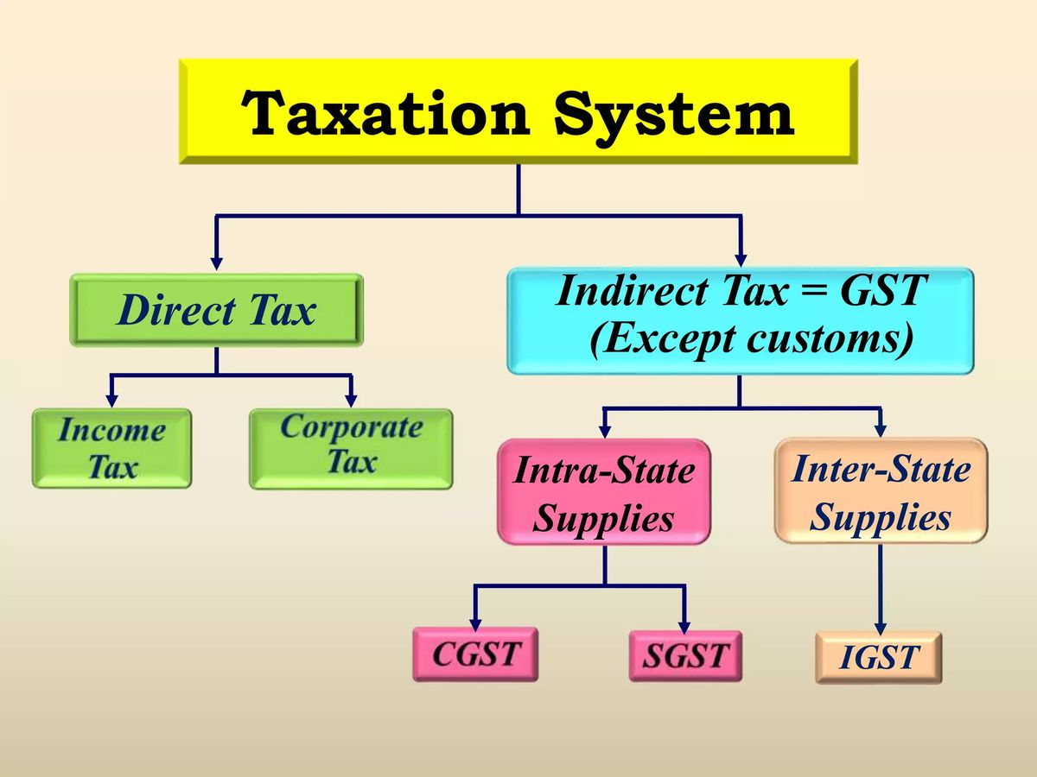

Slide 24
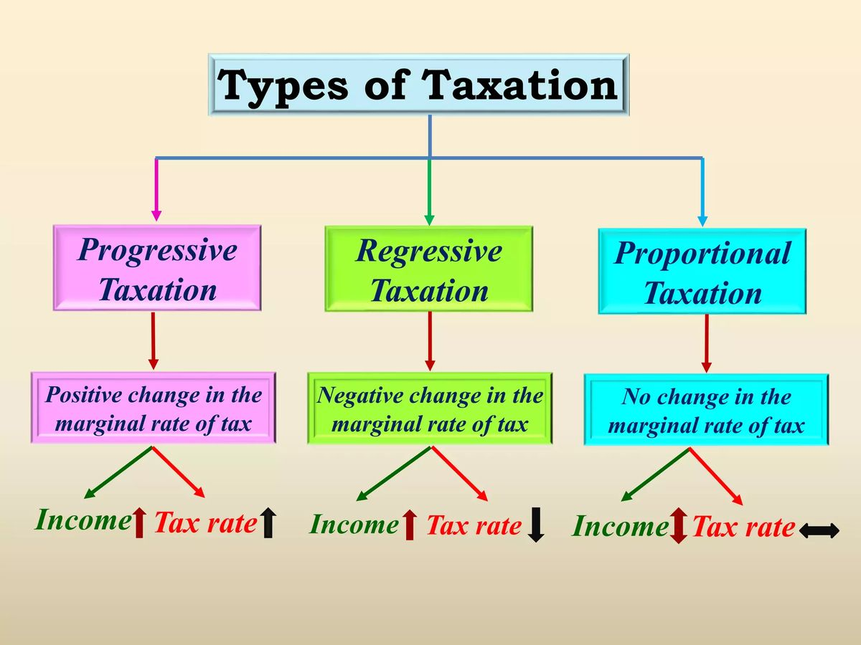

Slide 25
Digressive Taxation
A tax is called digressive when the rate of progression in taxation does not increase in the same proportion as the increase in income.
In this case, the rate of tax increases upto a certain limit, after that a uniform rate is charged.
Digressive tax is a combination of progressive and proportional taxation.
This type of taxation is often used in case of income tax. This is the case of income tax in India.

Slide 26
Some of the important definitions contained in the Act are of:
Person
Assessee
Assessment Year
Previous Year
Assessment
Income
Dividend

Slide 27
Important Terms
Income
Assessee
Assessment Year
Previous Year
Residential Status
Gross Total Income
Deductions
Total Income

Slide 28
Income – Sec.2(24)
Income means some monetary returns periodically received from some definite sources.
i.e, it is an earning or continuing income from the business or from a definite source.
It includes-
Income in cash
Income in kind
Gifts

Slide 29
Assessee
A person liable to pay any tax or any other sum of money under this Act.
Every person:
Who is assessable in respect of income or loss of another person or
Who is deemed to be an assessee or
Who is deemed to be assessee in default.

Slide 30
1. Basics of Income Tax Act, 1961
Introduced in 1961, effective from 1962
Administered by CBDT
Applicable to Individuals, HUFs, Firms, Companies, Trusts
Income of Previous Year (PY) is assessed in Assessment Year (AY)

Slide 31
Person: Sec 2(31)
According to law an assessee is a person by whom any tax is payable.
Person includes-
An individual
A firm
A HUF
A company
An association of Persons (AOP) or Body of Individuals (BOI)
A local authority
Any artificial and juridical person not include in the above category.

Slide 32
Income Tax liability of a person
Residential status of a person decides income tax liability.
Previous year is the year in which the income is earned.
Assessment year is the year in which the income is taxed.
AY consists of 12 months which commences on the 1st day of Aril immediately after the previous year.

Slide 33
Assessment
It is a process of determining the correctness of income of an assessee and of assessing the amount of tax payable by him and procedure for imposing tax liability.

Slide 34
Total Income and Tax payable
Income tax is levied on an assessee’s total income. Such total income must be computed as per the provision’s contained in the Income Tax Act 1961.
The step by step procedure of computation of total income for the purpose of levy of income tax is as follows.

Slide 35
Determination of residential status
Classification of income under different heads
Exclusion of income not chargeable to tax
Computation of income under each head
Clubbing of income of spouse, minor child etc
Set-off or carry forward and set-off of losses
Computation of Gross total Income
Deductions from Gross Total Income
Total Income
Application of the rates of tax on the total income
Surcharge
Education cess and secondary and higher education cess
Advance tax and tax deducted at source

Slide 36
2. Heads of Income
1. Salary – Wages, allowances, pensions, perquisites
2. House Property – Rental income less deductions
3. Business/Profession – Profits after expenses
4. Capital Gains – Profit from transfer of assets
5. Other Sources – Dividends, lottery, interest

Slide 37
3. Computation of Total Income
Gross Total Income = Sum of 5 heads
Adjust for Clubbing Provisions (Sec. 60–64)
Set-off & Carry Forward of Losses
Deduct Deductions (80C–80U)
Total Income → Apply Tax Rates + Cess = Tax Liability

Slide 38
4. Clubbing & Loss Adjustments
Minor’s income → clubbed with parent
Spouse’s income from gifted assets → transferor
Business Loss: 8 years
House Property Loss: 8 years
Speculation Loss: 4 years
Unabsorbed Depreciation: indefinite

Slide 39
5. Deductions (Chapter VI-A)
80C: Investments (PF, LIC, ELSS, PPF) – ₹1.5 lakh limit
80D: Health Insurance premium
80G: Donations
80TTA/80TTB: Savings Interest
80U: Disability benefits

Slide 40
Total Income and Tax payable
Income tax is levied on an assessee’s total income. Such total income must be computed as per the provision’s contained in the Income Tax Act 1961.
The step by step procedure of computation of total income for the purpose of levy of income tax is as follows.

Slide 41
Determination of residential status
Classification of income under different heads
Exclusion of income not chargeable to tax
Computation of income under each head
Clubbing of income of spouse, minor child etc
Set-off or carry forward and set-off of losses
Computation of Gross total Income
Deductions from Gross Total Income
Total Income
Application of the rates of tax on the total income
Surcharge
Education cess and secondary and higher education cess
Advance tax and tax deducted at source

Slide 42
2. Heads of Income
1. Salary – Wages, allowances, pensions, perquisites
2. House Property – Rental income less deductions
3. Business/Profession – Profits after expenses
4. Capital Gains – Profit from transfer of assets
5. Other Sources – Dividends, lottery, interest

Slide 43
3. Computation of Total Income
Gross Total Income = Sum of 5 heads
Adjust for Clubbing Provisions (Sec. 60–64)
Set-off & Carry Forward of Losses
Deduct Deductions (80C–80U)
Total Income → Apply Tax Rates + Cess = Tax Liability

Slide 44
4. Clubbing & Loss Adjustments
Minor’s income → clubbed with parent
Spouse’s income from gifted assets → transferor
Business Loss: 8 years
House Property Loss: 8 years
Speculation Loss: 4 years
Unabsorbed Depreciation: indefinite

Slide 45
5. Deductions (Chapter VI-A)
80C: Investments (PF, LIC, ELSS, PPF) – ₹1.5 lakh limit
80D: Health Insurance premium
80G: Donations
80TTA/80TTB: Savings Interest
80U: Disability benefits

Slide 46
6. Assessment of Different Persons
Individuals/HUF – Slab rates
Firms/LLPs – 30% flat
Companies – 25%/30% (with MAT)
Trusts/NGOs – Special exemptions

Slide 47
7. Tax Management Tools
TDS – Deducted by payer (salary, rent, contracts)
TCS – Collected by seller (liquor, scrap, foreign remittance)
Advance Tax – Paid in 4 installments
ICDS – 10 accounting standards for tax purposes

Slide 48
Direct Taxes Personal Taxation

Slide 49
ITR (Income Tax Return)
What is ITR? ITR (Income Tax Return) is an official form where individuals, HUFs, and entities report their annual income, tax deductions, and taxes paid to the Income Tax Department of India. Filing ITR is mandatory if your income exceeds the basic exemption limit or in certain specified situations.
Current Filing Period: For the financial year 2024-25 (April 1, 2024 – March 31, 2025), the ITR must be filed during the assessment year 2025-26 (April 1, 2025 – March 31, 2026).

Slide 50
Who must file income tax returns (ITR)
Individuals/HUF whose total income exceeds the basic exemption limit:
Under the old tax regime: ₹2,50,000 for individuals below 60 years, ₹3,00,000 for senior citizens (60-80 years), ₹5,00,000 for super seniors (above 80 years).
Under the new tax regime: ₹3,00,000 for all individuals regardless of age.
Anyone having income beyond these limits from any source, including salary, business, capital gains, house property, or other sources.
Certain cases where filing is mandatory even if income is below threshold, such as:
Deposits exceeding ₹50 lakh in savings accounts or ₹1 crore in current accounts.
Gross business receipts over ₹60 lakh or professional income over ₹10 lakh.
Payment of electricity bills exceeding ₹1 lakh.
Holding foreign assets or accounts.
Tax deducted at source (TDS) or collected (TCS) above prescribed limits.
Spending over ₹2 lakh on foreign travel.

Slide 51
Updated income tax slabs under the new tax regime
The new tax regime offers these slabs without most of the old exemptions and deductions.
Tax rebate under Section 87A is applicable up to ₹12 lakh taxable income, potentially making income up to ₹12 lakh effectively tax-free.
Taxpayers can still opt for the old tax regime, which retains the classic deductions and exemptions and has different slab rates.
Health and Education cess of 4% is applicable on the tax computed.
This new slab structure was introduced by the Finance Act 2024 and will apply starting from FY 2025-26 (AY 2026-27)
Income Range (₹) | Tax Rate
Up to 4,00,000 | Nil
4,00,001 to 8,00,000 | 5%
8,00,001 to 12,00,000 | 10%
12,00,001 to 16,00,000 | 15%
16,00,001 to 20,00,000 | 20%
20,00,001 to 24,00,000 | 25%
Above 24,00,000 | 30%

Slide 52
Standard Deduction (Income Tax) – FY 2024-25
What is Standard Deduction? A fixed amount salaried individuals and pensioners can deduct from their taxable salary income without submitting any proof.
Purpose: Simplifies tax filing by replacing earlier transport and medical allowances, reducing paperwork and providing automatic relief.
Current Limits:
₹75,000 under the New Tax Regime (default from FY 2024-25)
₹50,000 under the Old Tax Regime

Slide 53
Marginal relief
Marginal relief is a provision in India’s income tax law designed to prevent a sharp spike in tax liability for individuals whose income slightly exceeds a key tax-free or rebate threshold—specifically, the ₹12 lakh limit under the new regime (FY 2025-26 onwards).
How Marginal Relief Works (FY 2025-26, New Tax Regime)
If your income just exceeds ₹12 lakh, you lose the entire Section 87A rebate, causing your tax to jump abruptly.
Marginal relief ensures that the additional tax you pay does not exceed the extra income earned over ₹12 lakh. For instance, if your income is ₹12,10,000 (i.e., ₹10,000 more than ₹12 lakh), your final tax, after applying marginal relief, will not be more than ₹10,000—even if the slab-wise tax calculation suggests a higher amount.
This relief tapers off and is only available for incomes up to about ₹12,75,000–₹12,70,588, depending on the exact break-even, beyond which regular slab tax applies and no marginal relief is available

Slide 54

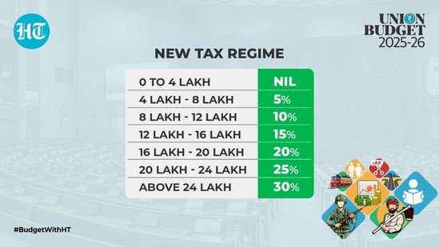
Marginal relief
Annual Income
Rs.1,19,900
Annual Income
Rs.1,21,000

Slide 55
Marginal relief
Income (₹) | Tax (Without Relief) | Income > ₹12L | Marginal Relief | Tax Payable (After Relief)
12,00,000 | 60,000 | 0 | 60,000 | 0
12,10,000 | 61,500 | 10,000 | 51,500 | 10,000
12,50,000 | 67,500 | 50,000 | 17,500 | 50,000
12,70,000 | 70,500 | 70,000 | 500 | 70,000

Slide 56
Marginal relief
Steps to Calculate Marginal Relief (for New Tax Regime, FY 2025-26):
Calculate tax without marginal relief on your total income as per the slab rates (including applicable cess).
Calculate the excess income you earn over the rebate or exemption limit (e.g., income exceeding ₹12,00,000).
Marginal Relief = Tax Payable without relief - Excess income over the limit
Final tax payable = Tax Payable without relief - Marginal relief
Add health and education cess (4%) on the final tax payable.
Example:
Income: ₹12,10,000
Tax without marginal relief: ₹61,500
Excess income over ₹12 lakh: ₹10,000
Marginal Relief = ₹61,500 - ₹10,000 = ₹51,500
Final tax payable = ₹61,500 - ₹51,500 = ₹10,000
Add 4% cess → Total tax = ₹10,400

Slide 57
Old Tax Regime: Income Tax Slabs (FY 2025-26, AY 2026-27)
Rebate under Section 87A: Available for total income up to ₹5,00,000, so no tax is payable up to this level for any category.
Deductions: You can claim all major deductions and exemptions, including Section 80C, HRA, standard deduction, LTA, etc.
Cess: Additional Health & Education cess at 4% is levied on total tax.
Higher basic exemption: Senior and super senior citizens enjoy higher exemption limits.
Income Range (₹) | Individuals below 60 years | Senior Citizens (60-80 years) | Super Senior Citizens (80+ years)
Up to 2,50,000 | Nil
Up to 3,00,000 |  | Nil
Up to 5,00,000 |  |  | Nil
2,50,001 to 5,00,000 | 5% | 5% (for 3–5 lakh)
5,00,001 to 10,00,000 | 20% | 20% | 20%
Above 10,00,000 | 30% | 30% | 30%

Slide 58
Financial Year (FY 24-25) Assessment Year (AY 25-26) Tax Year

Slide 59
Heads of Income (Section 14)
Under both the Income Tax Act, 1961 and the forthcoming Income Tax Bill, 2025, all income is classified under five main “heads of income.” This structure helps ensure every type of earning is accounted for accurately and taxed appropriately.
Income from Salary
Income from House Property
Income from Profits and Gains from Business or Profession
Income from Capital Gains
Income from Other Sources

Slide 60
Heads of Income
“Five heads of income" is explicitly mentioned in Section 14 of the Income Tax Act, 1961
Income from Salary
This includes all income received from employment: salary, wages, commissions, bonuses, pensions, perquisites, gratuity, and any other payments or benefits from an employer.
Income from House Property
Encompasses rental income or imputed rent from owning property (such as a house, apartment, or other buildings). Only the property owner is taxed under this head.
Profits and Gains from Business or Profession
Covers earnings from operating a business or practicing a profession, including services, manufacturing, trading, freelancing, or consulting activities.
Capital Gains
Any profit or gain arising from the sale or transfer of capital assets like land, buildings, shares, mutual funds, bonds, gold, etc., is taxed here. Capital gains can be “short-term” or “long-term” depending on how long the asset was held.
Income from Other Sources
All residual income not covered by the other heads, such as interest, dividends, lottery winnings, gifts, and certain types of miscellaneous revenue, is aggregated here.

Slide 61
Heads of Income - Income from Salary
Income from Salary (Section 15 to 17, Income Tax Act, 1961)
Income from salary includes all payments received by an individual from an employer in exchange for services rendered. This encompasses:
Basic salary/wages
Allowances: Dearness allowance, house rent allowance (HRA), transport, entertainment, etc.
Perquisites: Non-monetary benefits like a car, free accommodation, concessional loans, etc.
Bonuses and commissions
Pensions: Received after retirement or superannuation
Gratuity
Leave encashment
Advance salary or arrears
Employer contributions: Like to provident fund or superannuation funds (subject to certain limits)
Any other payment/benefit in connection with employment

Slide 62
Heads of Income - Income from Salary
Income from Salary (Section 15 to 17)
Section 15 describes the taxability of income from Salary (between employee & employer)
Section 16 explains about deductions available under salaries
Section 17 explains the components of the Salary like Monetary compensation, Perquisites, etc.

Slide 63
Heads of Income - Income from Salary
Income from Salary (Section 15 to 17)
Section 15 describes the taxability of income from Salary (between employee & employer)
(a) any salary due from an employer or a former employer to an assesse in the previous year, whether paid or not;
(b) any salary paid or allowed to him in the previous year by or on behalf of an employer or a former employer though not due or before it became due to him;
(c) any arrears of salary paid or allowed to him in the previous year by or on behalf of an employer or a former employer, If not charged to income-tax for any earlier previous year.
Explanation.—For the removal of doubts, it is hereby declared that where any salary paid in advance is included in the total income of any person for any previous year it shall not be included again in the total income of the person when the salary becomes due.

Slide 64
Heads of Income - Income from Salary
Deductions
Section 16 of the Income Tax Act, 1961 deals with the deductions that are allowed from “Income from Salary” while calculating an individual’s total taxable income under the salary head. Here’s a clear explanation:
Standard Deduction [Section 16(ia)]
All salaried individuals and pensioners can claim a flat deduction from gross salary income.
For FY 2024-25:
₹75,000 under the new tax regime (default)
₹50,000 under the old tax regime
Entertainment Allowance [Section 16(ii)]
Deductible only for government employees.
Maximum deduction: Least of these three amounts:
Actual entertainment allowance received,
20% of basic salary (excluding allowances/benefits), or
₹5,000
Professional Tax [Section 16(iii)]
Any amount paid on account of professional tax (levied by a state government) during the year is deductible from salary income.

Slide 65
Heads of Income - Income from Salary
Deductions & Exemptions
Deduction from salary in income tax refers to the amount subtracted from an individual’s gross salary to arrive at the taxable income.
Exemption refers to the deduction allowed by the law to reduce the amount of income that would otherwise be taxed.
Deductions reduce your taxable income, while exemptions (under section 10) exclude certain types of income from taxation altogether.

Slide 66
Heads of Income - Income from Salary
List of Exemptions (Section 10)
Exemption of Agriculture Income
Exemption on the Income of a HUF (interest are taxable)
Exemption on House Rent Allowance (HRA)
Exemption on allowances (Dearness Allowance, Leave Travel Allowance (LTA) or Leave Travel Concession (LTC), Mobile Reimbursement, Books and Periodicals, Food Coupons, Relocation Allowance, Children Education Allowances, Children's Hostel Allowances, Leave Encashment, Helper, etc)
Notes:
https://www.policybazaar.com/income-tax/section-10/

Slide 67
Heads of Income - Income from Salary
Type of Income/Allowance | Relevant Section | Exempt Limit / Notes
House Rent Allowance (HRA) | 10(13A) | Subject to rules on rent, salary, city, etc.
Leave Travel Allowance (LTA) | 10(5) | Domestic travel, twice in 4 years
Gratuity | 10(10) | Up to ₹20 lakh (Govt.), lesser for others
PF Interest | 10(11) | Up to ₹2.5 lakh interest per year
Life Insurance Maturity | 10(10D) | Subject to premium caps
Agricultural Income | 10(1) | 100% exempt
Notes:
https://www.policybazaar.com/income-tax/section-10/

Slide 68
Heads of Income - Income from Salary
List of Exemptions
Exemption on House Rent Allowance (HRA)
If rent is actually being paid, the individual can get an exemption as per the House Rent Allowance and that will be the least of the following:
Actual House Rent Allowance received
Actual Rent paid minus 10% of basic salary
40% of basic salary (50% in case of Mumbai, Chennai, Kolkata, Delhi)
Components of Salary
Basic
HRA
Allowances, etc
Notes:
https://www.policybazaar.com/income-tax/section-10/

Slide 69
Heads of Income - Income from Salary
Income Tax Exemptions in India (FY 2025-26 / AY 2026-27)
Exemption on House Rent Allowance (HRA)
If rent is actually being paid, the individual can get an exemption as per the House Rent Allowance and that will be the least of the following:
Actual House Rent Allowance received
Actual Rent paid minus 10% of basic salary
40% of basic salary (50% in case of Mumbai, Chennai, Kolkata, Delhi)
Components of Salary
Basic
HRA
Allowances, etc
Notes:
https://www.policybazaar.com/income-tax/section-10/

Slide 70

Section 10(13A): House Rent Allowance(HRA)
BASIC | 30,000 | PF | 2,000
HRA | 13,000 | Professional Tax | 200
CONVEYANCE | 2,000
SPECIAL ALLOWANCE | 3,000
MEDICAL ALLOWANCE | 1,250
LTA | 5,000
Total Earnings | 54,250
Basic Salary (no commission & DA) | 30,000*12 =3,60,000/-
10% of Basic Salary | 3,60,000*10% =36,000/-
Rent Paid per month | 10,000/-
Particulars | Calculation | Amount(INR)
a)Actual HRA Received | 13,000*12 | 1,56,000/-
b) 50% of Basic Salary (Mumbai region) | 3,60,000*50% | 1,80,000 /-
c)Rent paid (-)10% of basic salary | (10,000*12)-36,000/- | 84,000/-

Slide 71
New Regime (Default from FY 2025-26):
Greatly reduced number of exemptions; most Section 10 exemptions (like HRA, LTA, 80C, etc.) are not allowed.
Standard deduction (₹75,000) for salaried and pensioners, and employer NPS contributions are still available.
Very high basic exemption and rebate (no tax up to ₹12 lakh taxable income after standard deduction for salaried individuals)

Slide 72
Section 80 Deductions
Applies to a BROAD range of taxpayers—salaried, business owners, professionals, HUFs, and more. Where as section 16 applies ONLY to “Income from Salary” (i.e., applicable to salaried individuals and pensioners).
Types of Deductions: Cover various investments, payments, and spending, including:
Section 80C: Investments in PPF, NSC, LIC, tuition fees, ELSS, home loan principal repayment, etc. (up to ₹1.5 lakh).
Section 80D: Health insurance premium for self and family.
Section 80E/80G/80GG: Interest on education loans, donations to charity, rent paid, disability-related expenses, and many others.

Slide 73
Heads of Income - Income from Salary
List of Deductions
Standard deduction (Old Regime - Rs 50,000 & New Regime - Rs 75,000)
Income Tax Deduction under Section 80C upto Rs. 1.5 Lakhs (includes Life insurance, Public Provident Fund, Employee Provident Fund, Equity Linked Savings Scheme, Tuition fees, Home loan repayment (Principal amount), National Savings Certificate, National Pension Schemes, Sukanya Samriddhi Yojana, Tax saving bank deposits and post office deposits, Post Office Senior Citizens Savings Scheme)

Slide 74
Heads of Income - Income from Salary
List of Deductions
Subsections of Section 80C
Section 80CCC - Tax deduction to investments made in annuity plans of life insurance companies.
Section 80CCD - Tax deduction for investments made in government-based pension schemes such as the National Pension Scheme.
Section 80CCF - Tax deduction for investments made in long-term government infrastructure bonds.
Section 80CCG - Tax deduction for the investments made in equity savings schemes approved by the government.

Slide 75
Heads of Income - Income from Salary
List of Deductions
Section 80D provides a tax deduction for the amount paid as premiums for health insurance plans. It can be for the health insurance plans for self, spouse, children and dependent parents. (The allowable tax deduction is ₹25,000 for self or family and ₹50,000 if you are a senior citizen, ₹50,000 for senior citizen parents)
Section 80DD provides deduction to families of disabled persons for the purpose of caring for a disabled dependent. Deductions under Section-80DD can be claimed by families of disabled dependents and not the dependents themselves. (maximum deduction limit is Rs. 75,000 for medical expenses incurred on a dependent person with a disability. It can go as high as Rs. 1,25,000 for severe disability)

Slide 76
Heads of Income - Income from Salary
List of Deductions
Section 80DDB provides for a deduction to Individuals for medical expenses incurred for the treatment of specified diseases or ailments. Such expense is allowed as a deduction, subject to such conditions, and capped at such amount as specified. (The amount of the deduction depends on two factors - the age of the patient and the actual amount of expenditure. The deduction is up to Rs. 40,000 or the actual amount paid (whichever is less) for patients under 60 years of age and Rs. 1 lakh or the actual amount (whichever is less) for patients above 60 years of age)
List of diseases: Neurological Diseases, Malignant Cancers, Full blown Acquired Immuno Deficiency Syndrome, Chronic Renal Failure, Hematological Disorders.

Slide 77
Heads of Income - Income from Salary
List of Deductions
Section 80E allows you to claim a deduction for the education loan taken from any financial institution or approved charitable institution. There is no maximum limit specified under Section 80E of the Income Tax Act for the deduction on the interest paid on education loans. The deduction is allowed for the actual interest amount paid.
Section 80EE of the Indian Income Tax law allows first-time home buyers to get tax deductions on the interest they need to pay on a Home Loan. You can claim a deduction of up to ₹50,000 per financial year as per this section. You can continue to claim this deduction until you have fully repaid the loan.
Notes:
https://cleartax.in/s/house-property

Slide 78
Heads of Income - Income from Salary
List of Deductions
Section 80EEB of the Income Tax Act allows you to claim tax savings of up to Rs. 1.5 lakh on interest paid on a loan made specifically to purchase an electric car.
The deduction under Section 80EEB is allowed on interest payments in all the subsequent years until the loan is fully paid. The deduction is only applicable for loans sanctioned between January 1, 2019, and March 31, 2023.
Section 80G offers income tax deduction to an assesse, who makes donations to charitable organizations.
Notes:
https://cleartax.in/s/house-property

Slide 79
Heads of Income - Income from Salary
List of Deductions
Section 24 of the Income Tax Act lets homeowners claim a deduction of up to Rs. 2 lakhs on their home loan interest if the owner or his family reside in the house property.
Section 80TTA offers a deduction of up to Rs 10,000 on income earned from savings account interest made in a bank, co-operative society or post office.
Section 80TTB offers a deduction of up to Rs 50,000 on income earned from interest on all kinds of deposits for senior citizens.
Notes:
https://cleartax.in/s/house-property

Slide 80
Heads of Income - Income from Salary
Section | Type of Deduction | Limit/Details
80C | Investments & expenses | Up to ₹1.5 lakh per year
80D | Health insurance premium | Up to ₹1 lakh (varies by age)
80E | Interest on education loan | No upper limit
80G | Donations to charity | Amount varies by donee and donation
80GG | Rent paid by non-HRA receivers | Up to ₹5,000 per month or 25% income

Slide 81
Heads of Income - Income from Salary
List of Deductions
NO DEDUCTIONS APPLICABLE UNDER NEW TAX REGIME (except standard deduction of Rs 75,000/-)

Slide 82
Heads of Income - Income from Salary
Section 17 of the Act has mentioned the term ‘salary’, which included-
Wages;
Any annuity or pension;
Any gratuity;
Any charges, commissions, perquisites or benefits in lieu of or notwithstanding any compensation or wages;
any advance of salary;
Any payment received by a worker in regard to any time of leave not availed by him;
Notes:
https://blog.ipleaders.in/heads-income/

Slide 83
Heads of Income - Income from Salary
Section 17 of the Act has mentioned the term ‘perquisite’ (something special like a privilege to which a person has a special right because of his social position), which included-
In addition to their salary, the employees are often given some other benefits which may or may not be in cash form. For example, rent-free accommodation or car given by the employer to the employee.
Interest free loans, Movable assets, Educational expenses, Insurance premium paid on behalf of employees
Notes:
https://blog.ipleaders.in/heads-income/

Slide 84
Heads of Income - Income from Salary
Section 17 of the Act has mentioned the term ‘profits in lieu of salary’, which included-
the amount of any compensation due to or received by an assesse from his employer or former employer at or in connection with the termination of his employment or the modification of the terms and conditions relating thereto
Notes:
https://blog.ipleaders.in/heads-income/

Slide 85
SALARY
The amount of tax calculated is directly deducted from your salary before crediting it to your account. This amount deducted by the employer is known as TDS (Tax Deducted at Source).
Gross Salary
It is the total salary before accounting for various deductions. Gross salary can be arrived at by adding the basic salary, HRA, bonus, and allowances.
In-hand or Take-Home Salary
The amount left after all the above adjustments are made is known as the in-hand or take-home salary. It is the salary that employees receive at the end of every month. In other words, it is the amount that is credited into employees’ bank accounts every month.
Here is the formula to calculate in-hand salary –
Net Salary = Basic Salary + Allowances – (Provident fund + Gratuity + TDS + Professional Tax)

Slide 86
TAX SLAB
FINANCIAL YEAR 2024-25 (A.Y. 2025-26)
NEW TAX REGIME
Income Range | Tax Rate
0 - ₹3,00,000 | 0% | NIL
₹3,00,001 - ₹7,00,000 | 5% (tax rebate u/s 87A upto 7 lacs) | 5% on income which exceeds Rs 3,00,000 (Rs 20,000/-) (tax rebate u/s 87A upto 7 lacs)
₹7,00,001 - ₹10,00,000 | 10% | Rs. 20,000 + 10% on income more than Rs 7,00,000 (Rs 50,000/-)
₹10,00,001 - ₹12,00,000 | 15% | Rs. 50,000 + 15% on income more than Rs 10,00,000 (Rs 80,000/-)
₹12,00,001 - ₹15,00,000 | 20% | Rs. 80,000 + 20% on income more than Rs 12,00,000 (Rs 1,40,000/-)
Above ₹15,00,000 | 30% | Rs. 1,40,000 + 30% on income more than Rs 15,00,000
Cess | 4% p.a. of Taxable Income
Notes:
https://economictimes.indiatimes.com/wealth/income-tax-slabs?from=mdr

Slide 87
Example - NEW TAX REGIME
FINANCIAL YEAR 2024-25 (A.Y. 2025-26)
Particulars | Amount (In Rs)
Gross total income | 20,00,000
Standard deduction from salary/pension | (75,000)
Deduction under section 80CCD (2) | (2,00,000)
Net taxable income | 17,25,000
Total income tax liability Rs 2,07,500/-
The final tax payable on gross income of Rs 20 lakh is Rs 2,15,800 (including 4% cess), after claiming deductions of Rs 2.75 lakh.
Notes:
https://economictimes.indiatimes.com/wealth/income-tax-slabs?from=mdr

Slide 88
TAX SLAB
FINANCIAL YEAR 2024-25 (A.Y. 2025-26)
OLD TAX REGIME*
Income Range | Tax Rate
0 - ₹2,50,000 | 0%
₹2,50,001 - ₹5,00,000 | 5%
₹5,00,001 - ₹10,00,000 | 20%
Above ₹10,00,001 | 30%
Cess | 4% p.a. of Taxable Income
*APPLICABLE TO NON-SENIOR CITIZEN
Notes:
https://economictimes.indiatimes.com/wealth/income-tax-slabs?from=mdr

Slide 89
Example - OLD TAX REGIME
FINANCIAL YEAR 2024-25 (A.Y. 2025-26)
Particulars | Amount (in Rs)
Gross total income | 17,00,000
Section 80C | (1,50,000)
Section 80 CCD(1b) NPS investment | (50,000)
Section 80D – medical insurance premium | (25,000)
Section 80TTA | (10,000)
Net taxable income | 14,65,000
Total income tax liability Rs 2,52,000/-
The final tax payable on gross income of Rs 17 lakh is Rs 2,62,080 (including 4% cess), after claiming deductions of Rs 2.75 lakh.
Notes:
https://economictimes.indiatimes.com/wealth/income-tax-slabs?from=mdr

Slide 90
SURCHARGE
If an individual's net taxable income exceeds a specified level, then a surcharge is levied.
The surcharge is levied on the income tax payable amount before the levy of cess.
According to income tax laws, a surcharge is applicable if an individual's taxable income exceeds Rs 50 lakh.

Slide 91
SURCHARGE
Surcharge rate from April 1, 2023 under NEW TAX REGIME
Income range | Surcharge rate
Up to Rs 50 lakh | Nil
More than Rs 50 lakh but up to Rs 1 crore | 10%
More than Rs 1 crore but up to Rs 2 crore | 15%
More than Rs 2 crore | 25%
Surcharge rate under OLD TAX REGIME
Income range | Surcharge rate
Upto Rs 50 lakh | Nil
More than Rs 50 lakh but up to Rs 1 crore | 10%
More than Rs 1 crore but up to Rs 2 crore | 15%
More than Rs 2 crore but up to Rs 5 crore | 25%
More than Rs 5 crore | 37%
Notes:
https://economictimes.indiatimes.com/wealth/income-tax-slabs?from=mdr

Slide 92
SURCHARGE
There are certain exceptions to the surcharge rates mentioned above. If an individual has earned income from capital gains (short term or long term) through the sale of equity shares and equity mutual funds or dividend income, the surcharge will not exceed 15%, irrespective of the income range.
While understanding the concept of surcharge, one must also know the term marginal relief. The concept of marginal relief kicks in when the amount of surcharge on income tax payable exceeds the increase in income over the specified limit.
Notes:
https://economictimes.indiatimes.com/wealth/income-tax-slabs?from=mdr

Slide 93
SURCHARGE
Suppose an individual has a net taxable income of Rs 51 lakh. As the income exceeds Rs 50 lakh, the surcharge will be applicable at the rate of 10%.
The tax payable on Rs 51 lakh (without surcharge) is Rs 13,42,500. The surcharge amount will be Rs 1,34,250 (at 10% of tax payable).
Here the surcharge amount Rs 1,34,250 is higher than the additional income above Rs 50 lakh (Rs 1,00,000). This is where the concept of marginal relief kicks in.
Notes:
https://economictimes.indiatimes.com/wealth/income-tax-slabs?from=mdr

Slide 94
SURCHARGE
To know the amount of marginal relief that is applicable, one needs to calculate income tax payable on Rs 50 lakh. This is because no surcharge will be applicable till the income exceeds Rs 50 lakh. The income tax payable will be Rs 13,12,500.
Now add income above Rs 50 lakh (Rs 1 lakh) to the income tax payable amount. The tax payable amount under marginal relief will be Rs 14,12,500.
Notes:
https://economictimes.indiatimes.com/wealth/income-tax-slabs?from=mdr

Slide 95
SURCHARGE
To ascertain the actual income tax payable with surcharge, compare the normal tax liability (before surcharge and cess) and tax liability after marginal tax relief (without cess).
Normal tax liability is Rs 13,42,500 and tax liability after marginal tax relief is Rs 14,12,500. The surcharge that will be applicable is Rs 70,000 (Rs 14,12,500 - Rs 13,42,500).
The final tax payable amount will be Rs 13,42,500 (Tax payable amount) + Rs 70,000 (Surcharge) + Rs 56,500 (Cess at 4% on Rs 14,12,500) = Rs 14,69,000.
Notes:
https://economictimes.indiatimes.com/wealth/income-tax-slabs?from=mdr

Slide 96
Important Terminologies
Residential Status
Resident – World income is taxable in India
Non Resident Indian (NRI) – Only income arising or accruing in India is taxable in India
The Reserve Bank of India (RBI) and the Income Tax Act have distinct definitions of an NRI. The definition of NRI as per RBI focuses on the intention of stay, whereas NRI status as per income tax is determined by the actual duration of stay in India.

Slide 97
Important Terminologies
RBI's NRI Definition: An individual is an NRI if they've not resided in India for more than 182 days during the preceding financial year.
Income Tax Act's NRI Definition: An individual is an NRI if they've been in India for less than 182 days in the preceding financial year or if they've been in India for less than 60 days during the previous year and 365 days or less during the past four years.

Slide 98
HEADS OF INCOME
Income From Salary
Meaning of Salary:
Wages
Pension
Annuity
Gratuity
Advance Salary paid
Fees, Commission, Perquisites, Profits in lieu of or in addition to Salary or Wages
Annual accretion to the balance of Recognized Provident Fund
Leave Encashment
Transferred balance in Recognized Provident Fund
Contribution by Central Govt. or any other employer to Employees Pension A/c as referred in Sec. 80CCD.

Slide 99
Income From Salary
1. CTC
2. Gross Salary
-is employee provident fund (EPF) and gratuity subtracted from the Cost to Company (CTC). To put it in simpler terms, Gross Salary is the amount paid before deduction of taxes or other deductions and is inclusive of bonuses, over-time pay, holiday pay, and other differentials.
For the same example listed above, let’s deduce Mr. A yearly salary by subtracting gratuity and Employee Provident Fund contributions.
Rs. 4,00,000 - Rs. 21,600 - Rs. 18,326 = Rs. 3,60,074

Slide 100
Income From Salary
Particulars | Amount
Basic Salary | —
Add: | —
1. Fees, Commission and Bonus | —
2. Allowances | —
3. Perquisites (Company car, fuel reimbursement etc) | —
4. Retirement Benefits | —
5. Fees, Commission and Bonus | —
Gross Salary | —
Less: Deductions from Salary | —
1. Entertainment Allowance u/s 16 | —
2. Professional Tax u/s 16 | —
Net Salary | —

Slide 101
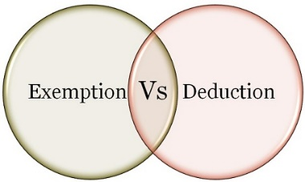
Income From Salary
Deduction/Exemption
What is the difference between Exemption and deduction?
If an income is exempt from tax, then it is not included in the computation of income. However, the deduction is given from income chargeable to tax. Exempt income will never exceed the amount of income. However, the deduct may be less than or equal to or more than the amount of income.
Exemption: Section 10 deals with exemptions
Deduction: Section 80 C to 80 U deals with deduction

Slide 102
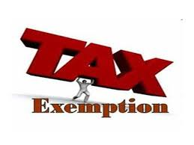
Income From Salary
Exemption
Section 10(1) to Section 10(38) Deals with exempt Income
Section 10(5)-Leave Travel Allowance
The bills for your travel against LTA can be claimed for exemption. It is allowed to be claimed twice in a block of four years. The current block is 2018 to 2022.
Exempt from tax in the hands of employee as per following.
If journey by Air –Economy class fare of the national carrier( Air India) by shortest route or the amount spent whichever is less.
If journey by Rail – AC First class fare by shortest route or the amount spent whichever is less
Where places of origin of Journey and destination are connected by rail & journey is performed by any other mode of transport- AC First class fare by shortest route or the amount spent whichever is less.
Where places of origin of Journey and destination are not connected by rail,
a) Recognized public transport exists- First class or deluxe class fare by the shortest route or the amount spent, whichever is less.
b) No recognized public transport exists - AC First class rail fare by Shortest route or the amount spent whichever is less

Slide 103
Income From Salary
Exemption
Section 10(1) to Section 10(38) Deals with exempt Income
Section 10(5)-Leave Travel Allowance Conditions:
LTA should be uniform to all the employees
Employers need to collect and scrutinize the proof of travel (ticket etc.)
Limited to the actual expenses incurred
Any Leave encashed for the purpose of Leave travel or home travel concession is taxable.
Foreign Travel – The exemption is not available in case of Foreign Travel
The Exemption is not available to more than 2 surviving children of an individual born after 1.10.1998. However, this restriction is not there in respect of children born before 1.10.1998.

Slide 104
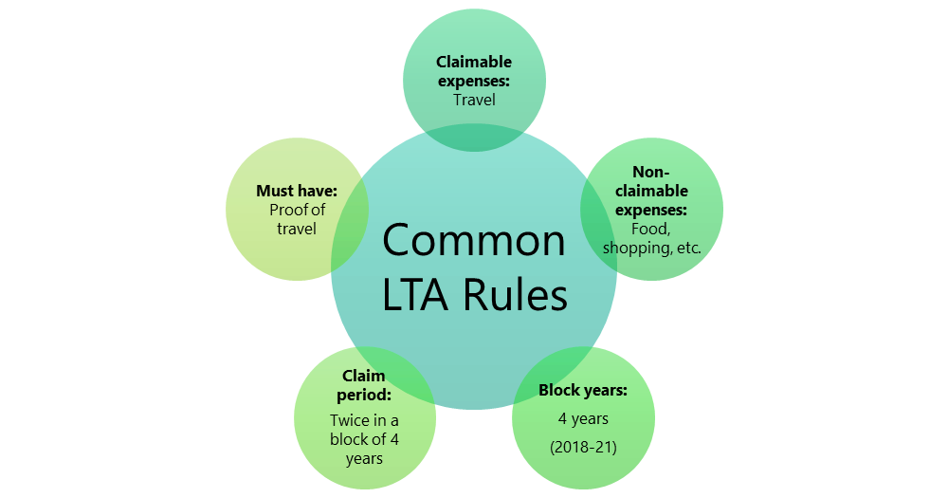
Income From Salary
Exemption
Section 10(5)-Leave Travel Allowance

Slide 105
Income From Salary
Exemption
Section 10(13A): House Rent Allowance(HRA)
This is the famous exemption which is used by many salaried individuals. However, the wrong belief is that whatever the rent they pay is actually exempted from their income. The reality is different. The amount of exemption is least of the following.
a) Actual HRA Received
b) 40% of Salary (50%, if house situated in Metro Region)
c) Rent paid minus 10% of salary
(Salary = Basic + DA (if part of retirement benefit) + Turnover based Commission)

Slide 106
Income From Salary
Exemption
Allowances Exempt under Section 10(14)(I)-No limit
Travelling Allowance
Daily Allowance
Conveyance Allowance:-This is the different allowance than transport allowance. It is the expenditure granted to an employee to meet the expenses on conveyance in performing of his office duties.
Helper Allowance
Academic Allowance:- Allowance granted for encouraging academic, research & training pursuits in educational & research Institutional.
Uniform allowance

Slide 107

Deductions under Chapter VI-A
Section 80C
Maximum Limit- Rs.1,50,000/-
You can save tax on salary income from this section alone
Different Investment in this section includes
Life Insurance premium (Paid by an individual, spouse, and child. In the case of HUF, on the life of any member of HUF).
EPF-Employee contribution can be claimed for deduction.
Public Provident Fund (Paid by an individual, spouse, and child. In the case of HUF, on the life of any member of HUF).
National Savings Certificate (NSC).
Sukanya Samriddhi Account
ELSS or Tax Saving Mutual Funds
Senior Citizen Savings Scheme
5-Years Post Office or Bank Deposits.
Tuition fee of kids.
Principal payment towards home loan.
Stamp duty and registration cost of the house.

Slide 108
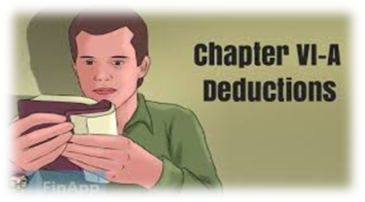
Deductions under Chapter VI-A
Section 80CCC
Deduction under Sec.80CCC is available only for individuals. Contribution to an annuity plan of the LIC of India or any other insurer for receiving the pension. Do remember that the amount should be paid or deposited out of income chargeable to tax.
Note:- this is also the part of the combined limit of Rs.1.5 lakh available under Sec.80C Sec.80CCC, and Sec.80CCD(1)

Slide 109
Deductions under Chapter VI-A
NPS Tax Benefit-Section 80CCD1
An individual’s maximum 20% of annual income (Earlier it was 10% but after Budget 2017, it increased to 20%) or an employees (10% of Basic+DA) contribution will be eligible for deduction.
Note:- this is also the part of the combined limit of Rs.1.5 lakh available under Sec.80C Sec.80CCC, and Sec.80CCD(1)
NPS Tax Benefit-Section 80CCD2
There is a misconception among many that there is no upper limit for this section. However, the limit is least of 3 conditions.
1) Amount contributed by an employer,
2) 10% of Basic+DA and
3) Gross Total Income.
This is additional deduction which will not form the part of Sec.80C limit.
The deduction under this section will not be eligible for self-employed.

Slide 110
Deductions under Chapter VI-A
NPS Tax Benefit-Section 80CCD(1B)
This is the additional tax benefit of up to Rs.50,000 eligible for income tax deduction and was introduced in the Budget 2015, One can avail the benefit of this Sect.80CCD (1B) from FY 2015-16.
Both self-employed and employees are eligible for availing this deduction.
This is over and above Sec.80CCD (1).

Slide 111
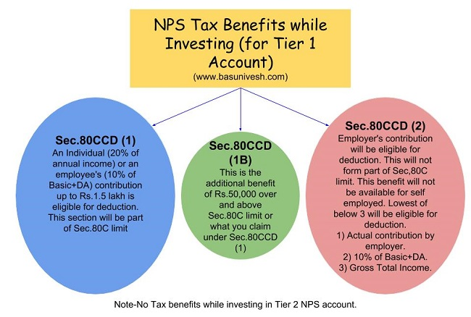
Deductions under Chapter VI-A
NPS Tax Benefit Summary

Slide 112
Deductions under Chapter VI-A
Section 80GG
This section only applies to those who have not availed HRA in their salary or not claiming the deduction on their rent in any of the other sections of income
Conditions:
Applicable to Individual or HUF.
Tax Payer may be either salaried or a self-employed. However, must not be getting HRA.
Tax Payer himself or spouse/Minor Child/HUF of which he is a member should not own any accommodation at a place where he is doing a job or business
If Tax Payer owns a house at a place other than the place noted above, then the concession in respect of self-occupied property is not claimed by him [Under Section 23 (2) (a) or 23 (4) (a)].
Tax Payer has to file a declaration in Form No.10BA regarding the expenditure incurred by him towards the payment of rent.

Slide 113
Deductions under Chapter VI-A
Section 80GG
How much amount of deduction one can avail under Sec. 80GG?
If the all five conditions are satisfied, the amount deductible under Section 80GG is LEAST OF THE FOLLOWING.
Rs.5, 000 per month;
25% of total income of taxpayer for the year; or
Rent Paid less 10% of total income (Rent Paid-10% of Total Income).

Slide 114
Deductions under Chapter VI-A
Section 80GG
Example:
What is total income for the purpose of Sec. 80GG?
We can calculate it as below.
Total Income=Gross Total Income-LTCG-STCG-Income referred under the Sec.115A-Amount deductible under Sec.80C to 80U (except Section 80GG)
Mr. X’s total income (calculated as per above formula) is Rs.4, 00,000. He pays an annual rent of Rs.1, 50,000. Then least of the below will be applicable for deduction under Sec. 80GG.
Rs.60, 000 per year.
Rent Paid-10% of Total Income=Rs.1,50,000-Rs.40,000=Rs.1,10,000’-.
25% of Total Income i.e. Rs.1, 00,000/-.
So least of the above will be Rs.60, 000/-, which one can claim under Section 80GG for that particular FY.

Slide 115
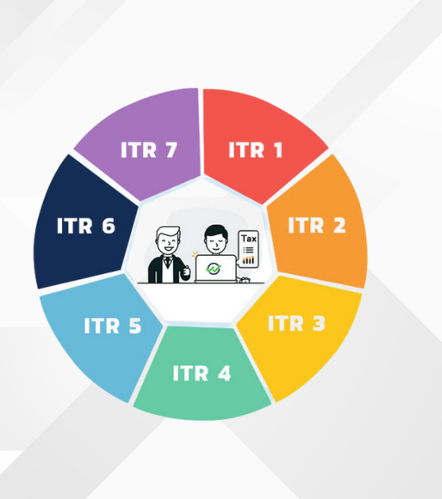
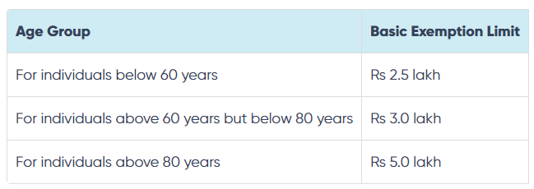
Income Tax Return (ITR)
ITR is a form used to file information about income and taxes to the Income Tax Department.
Different forms are used depending on the nature of income and the type of taxpayer.
The forms range from ITR 1 to ITR 7, each serving different purposes.
Irrespective of age, basic exemption limit under the new tax regime is Rs.3 Lakh.

Slide 116
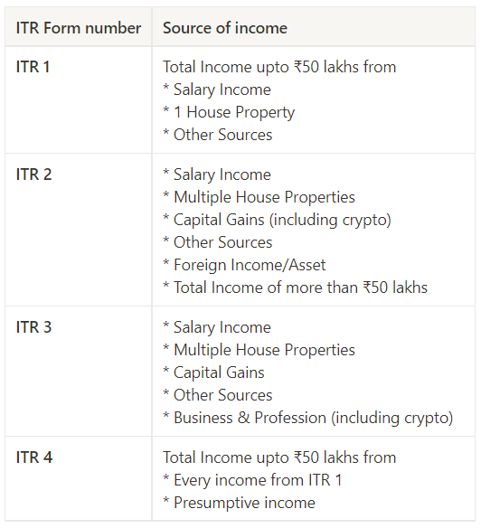
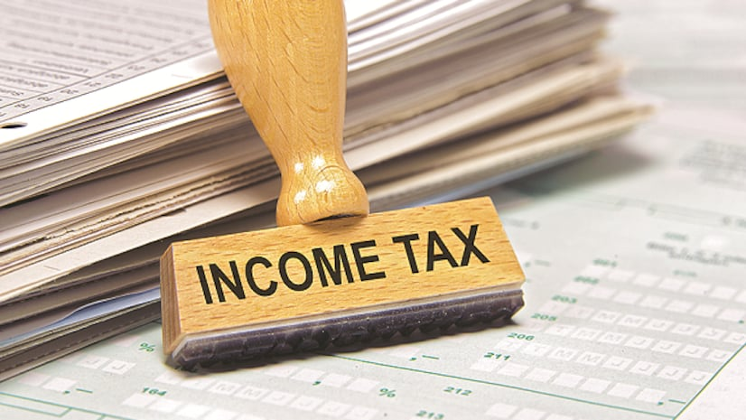

Slide 117
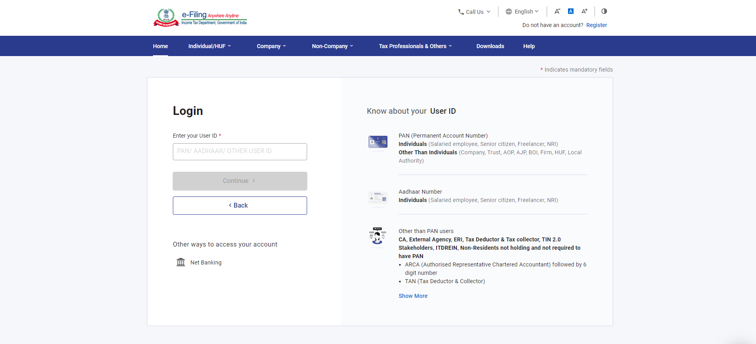
Income Tax E-Filing ( ITR-1)
https://eportal.incometax.gov.in/

Slide 118
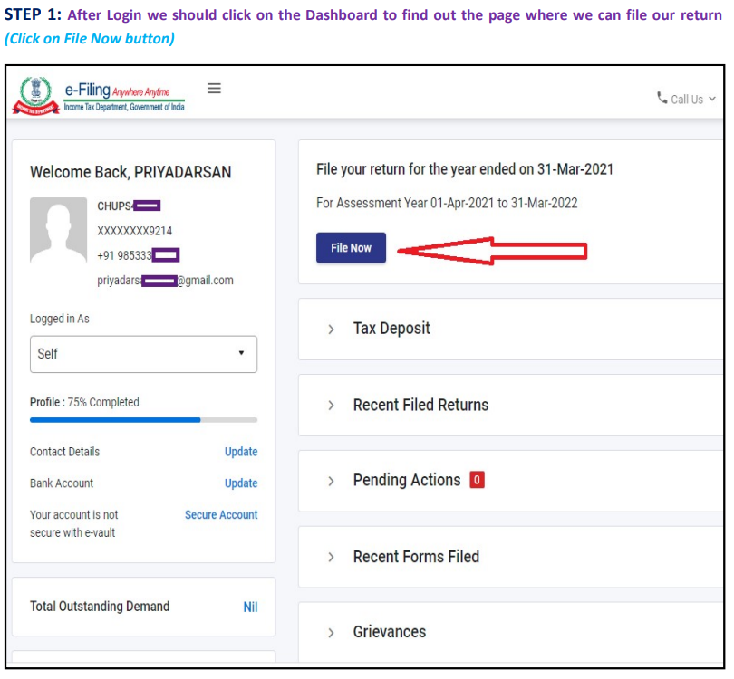

Slide 119
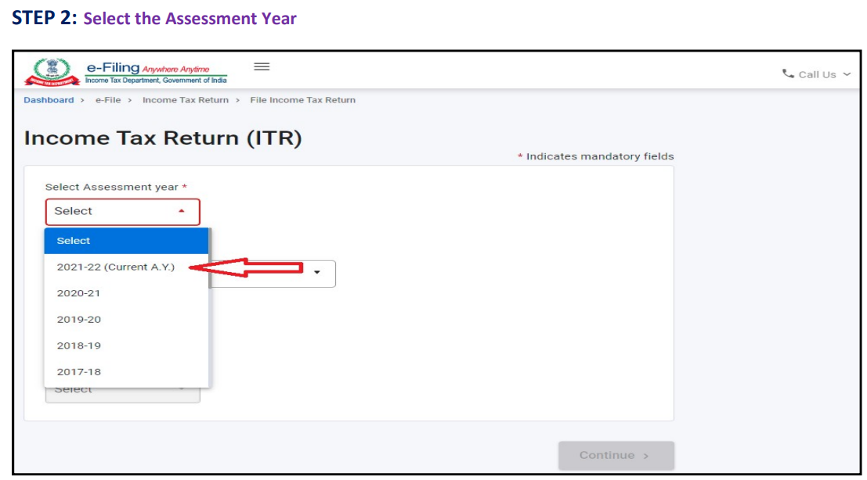

Slide 120
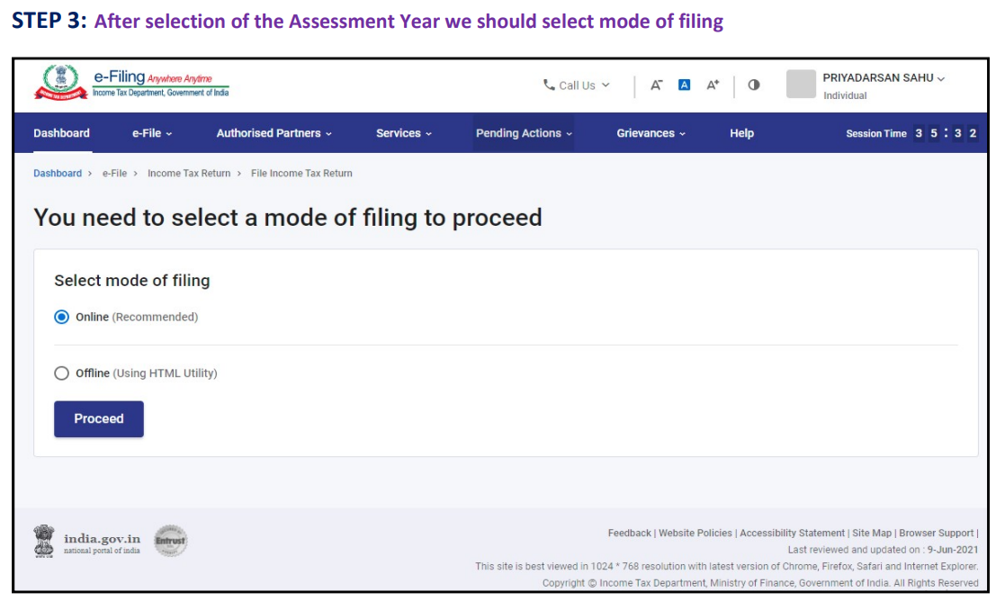

Slide 121
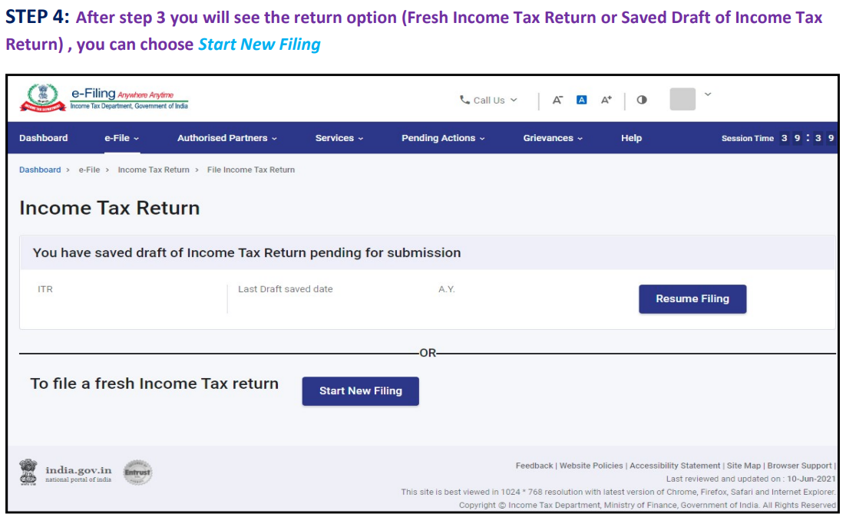

Slide 122
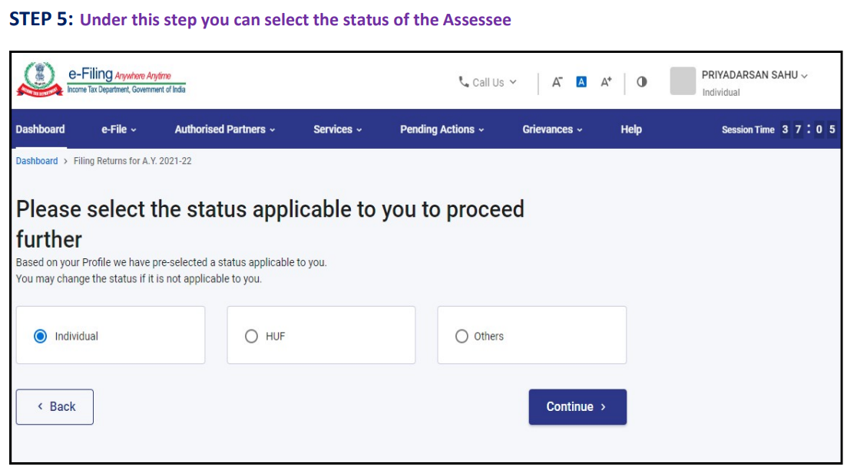

Slide 123
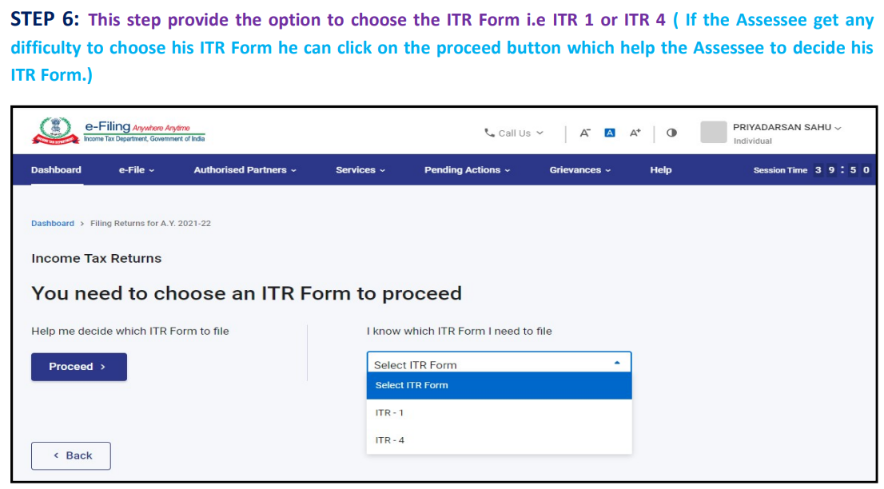

Slide 124
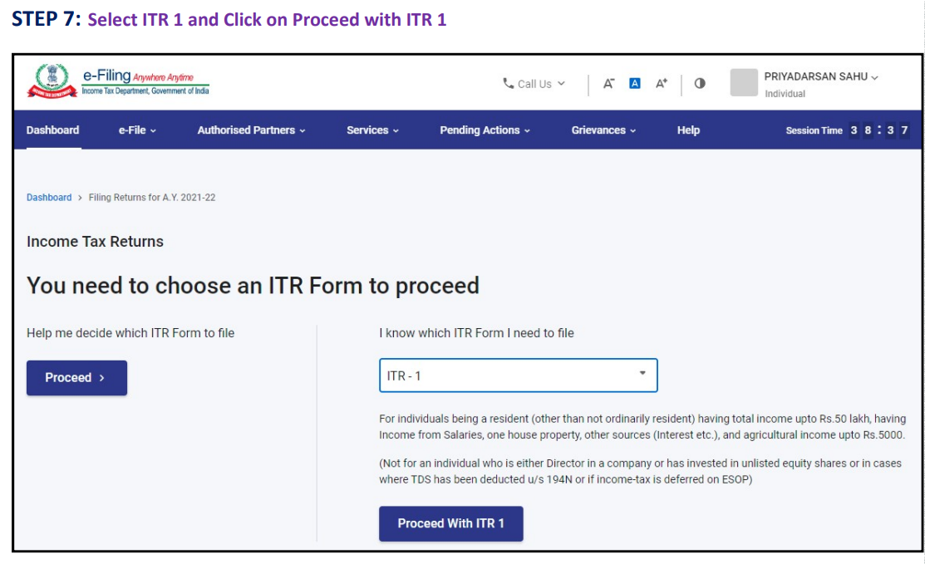

Slide 125
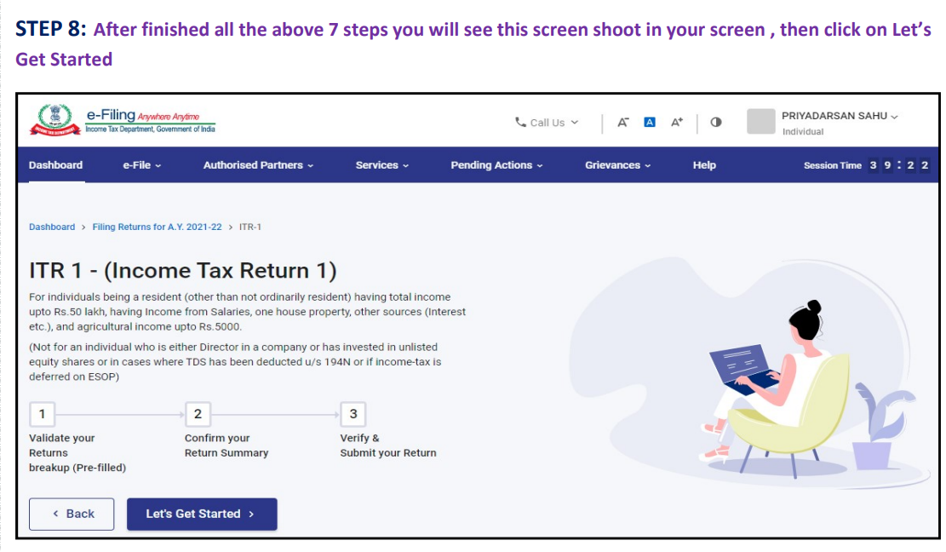

Slide 126
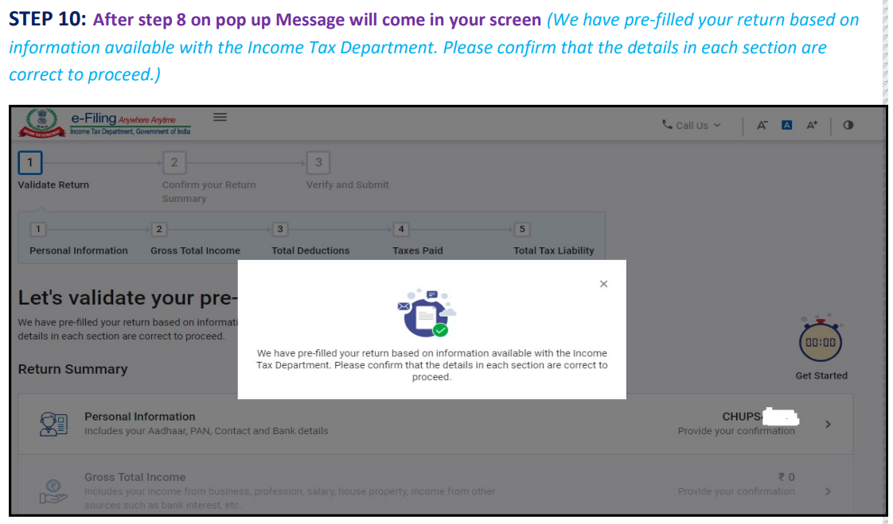

Slide 127
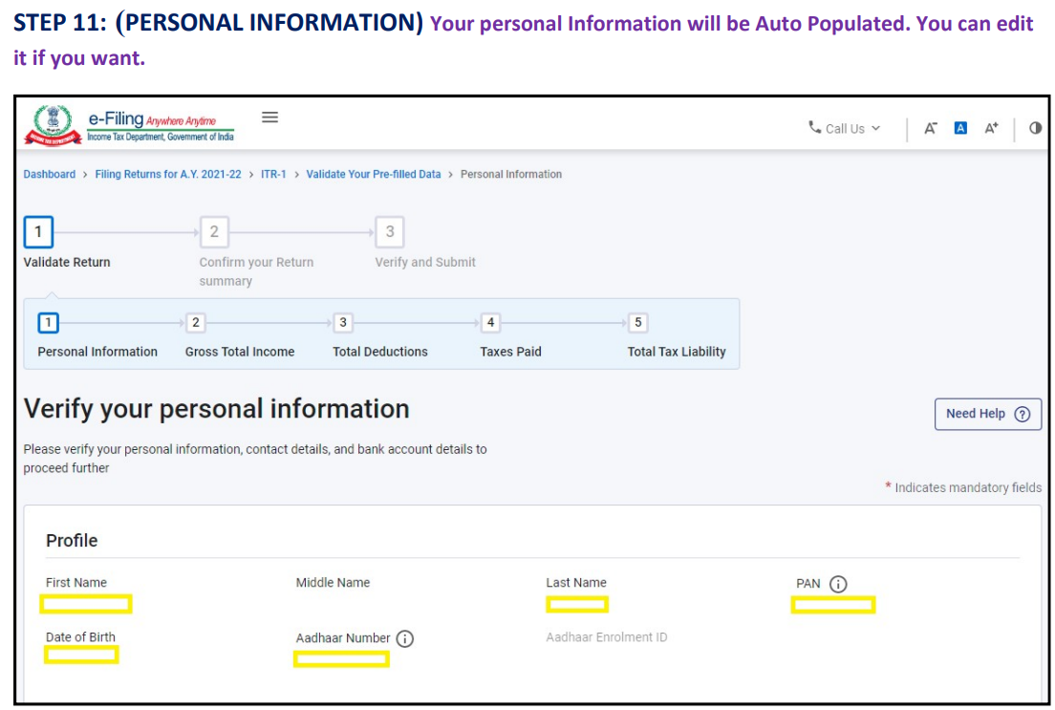

Slide 128
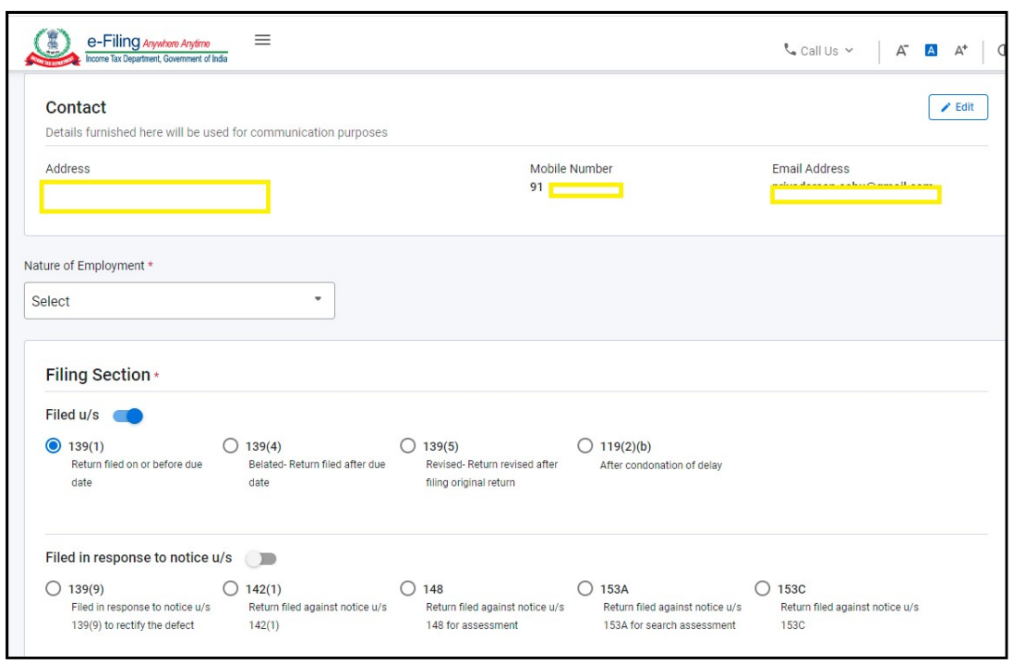

Slide 129
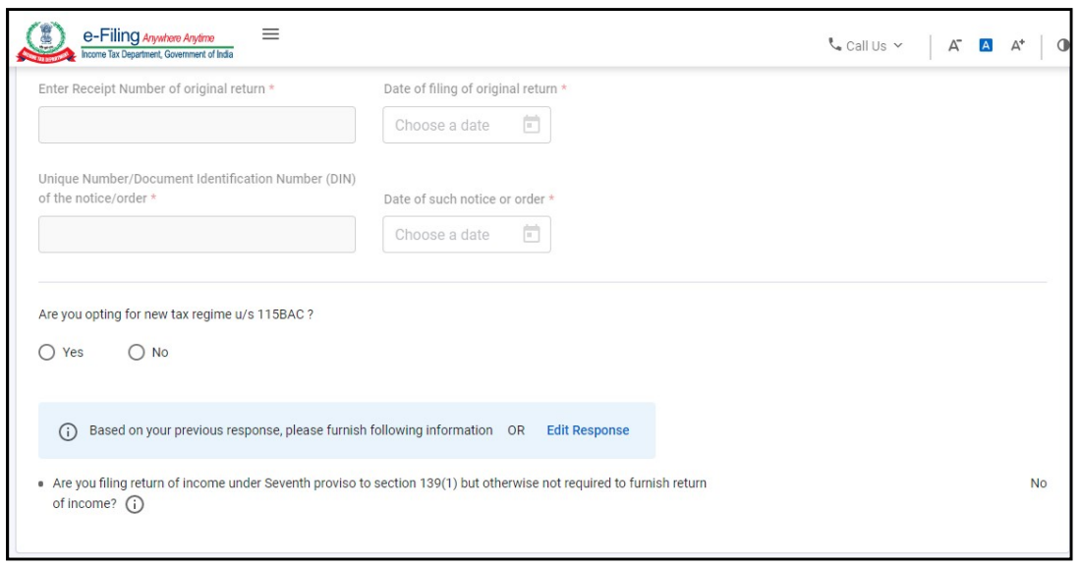

Slide 130
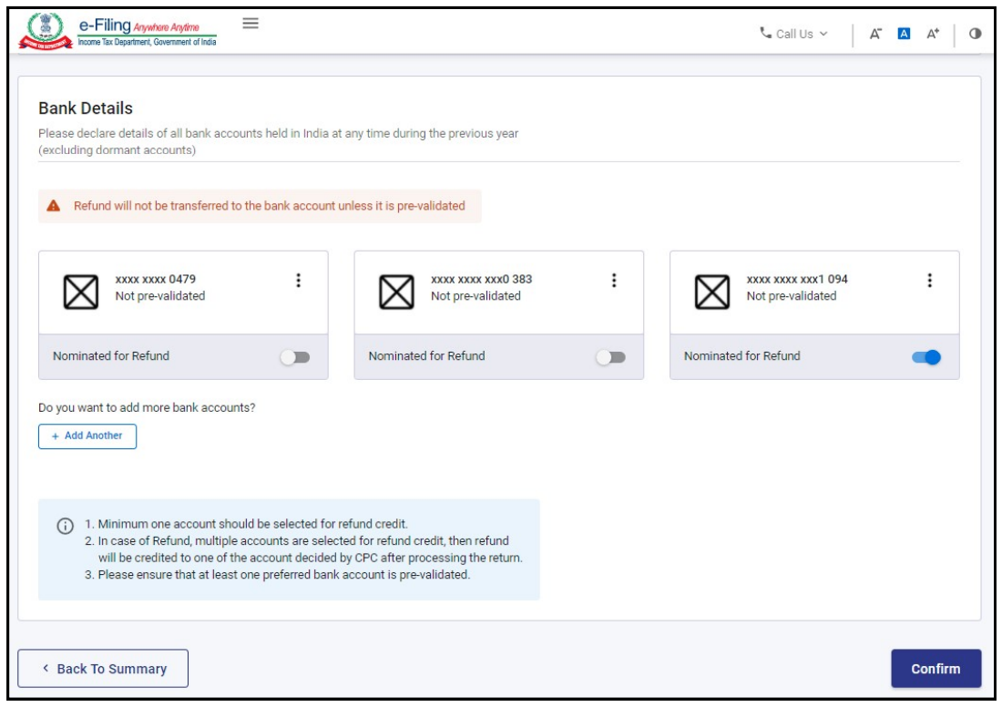

Slide 131
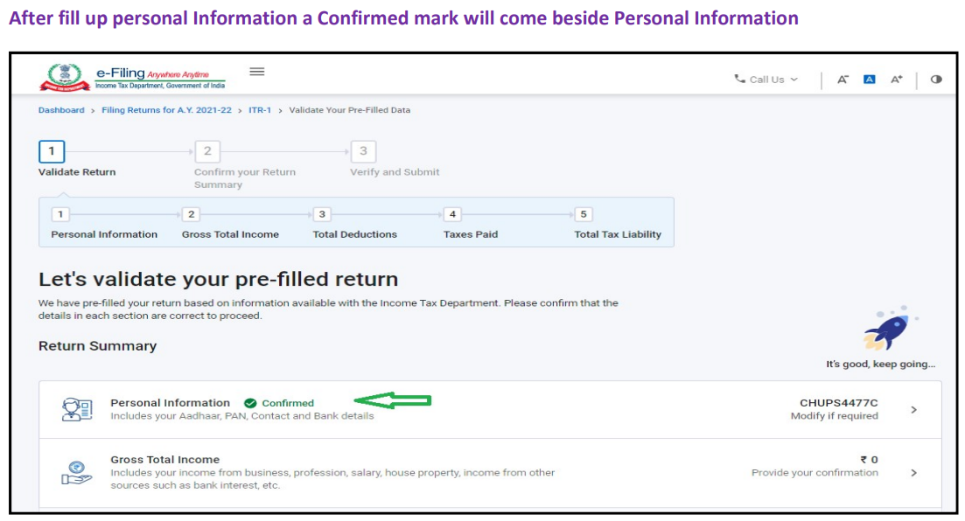

Slide 132
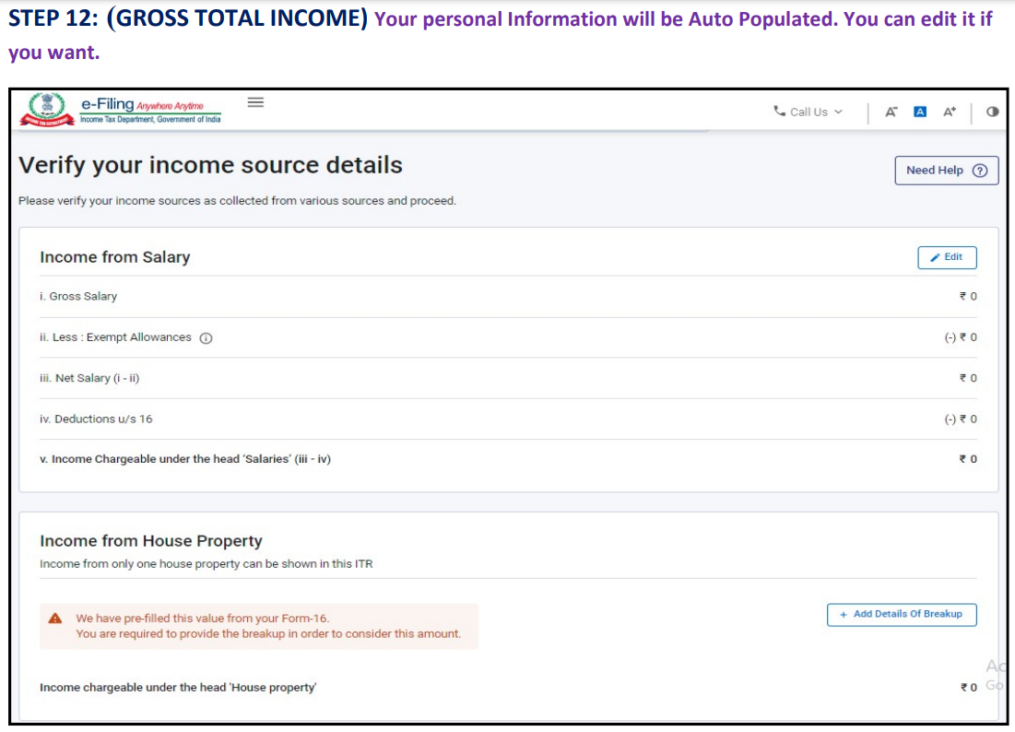

Slide 133
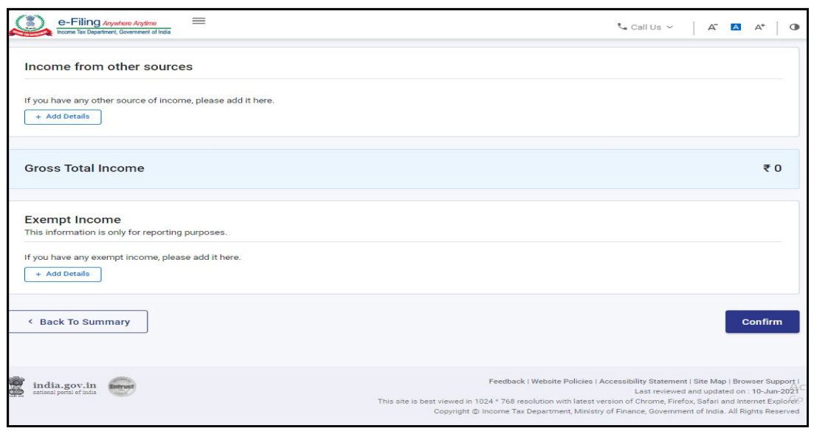

Slide 134
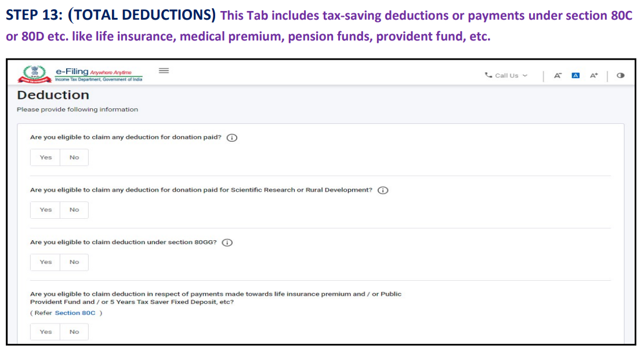

Slide 135
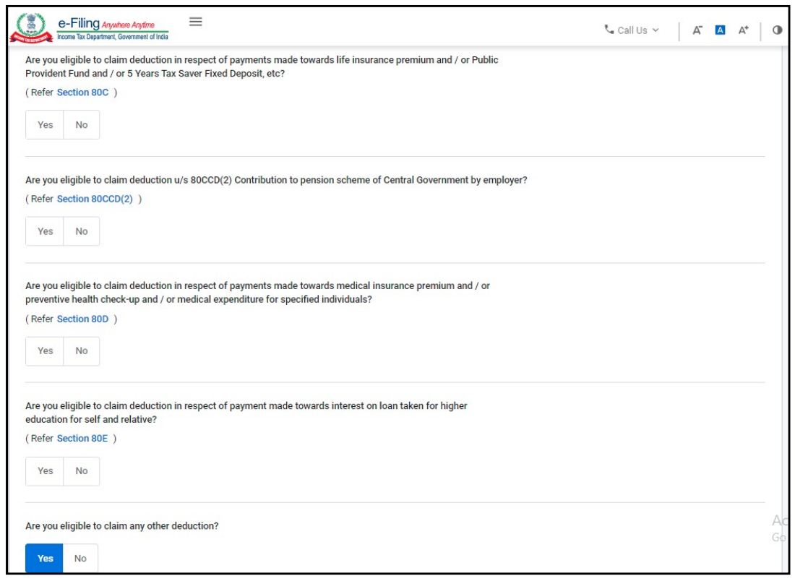

Slide 136
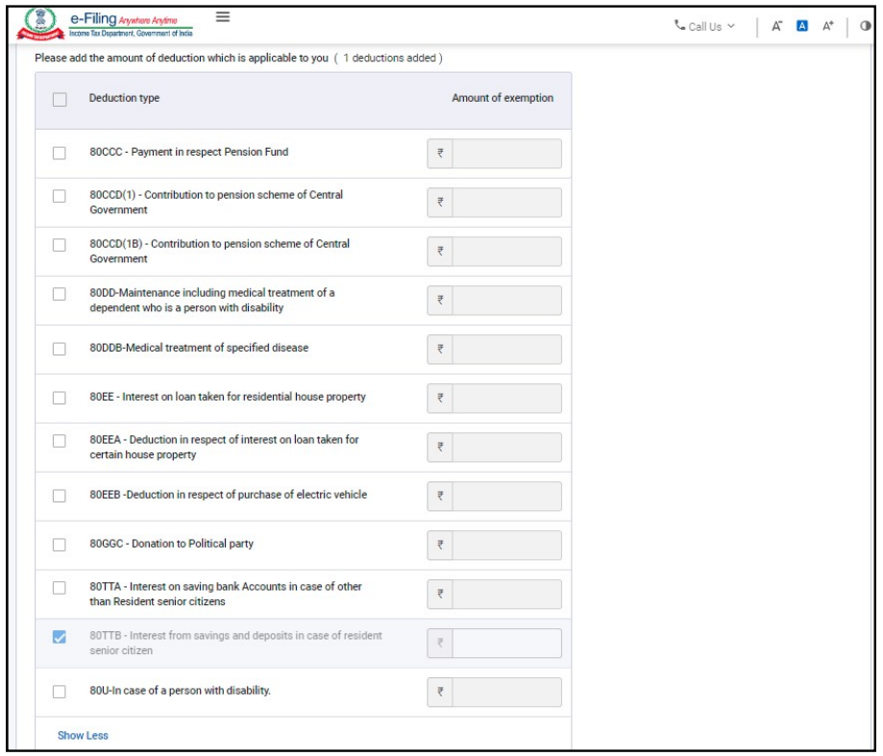

Slide 137
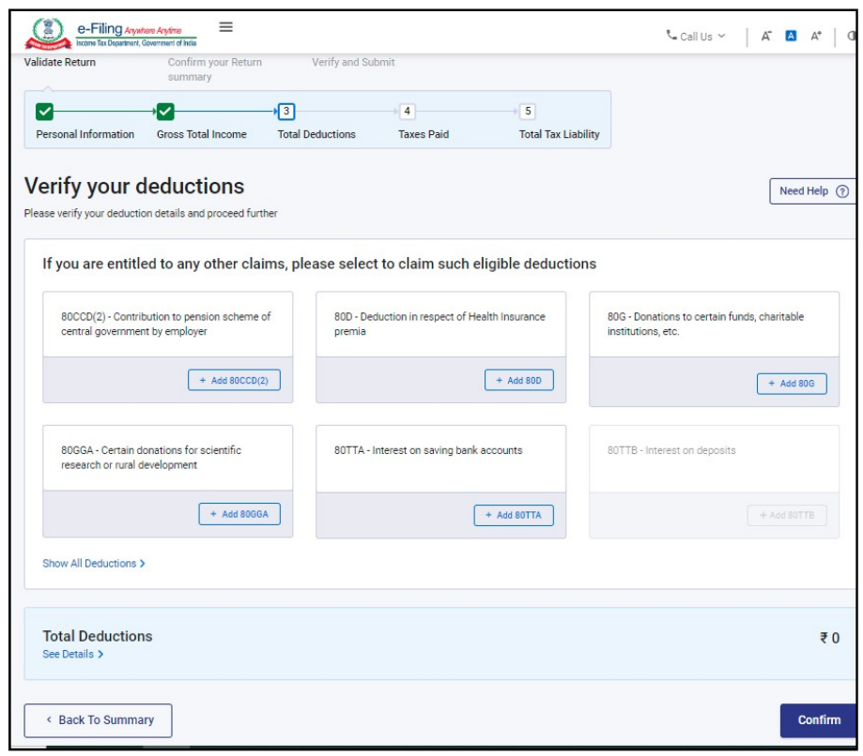

Slide 138
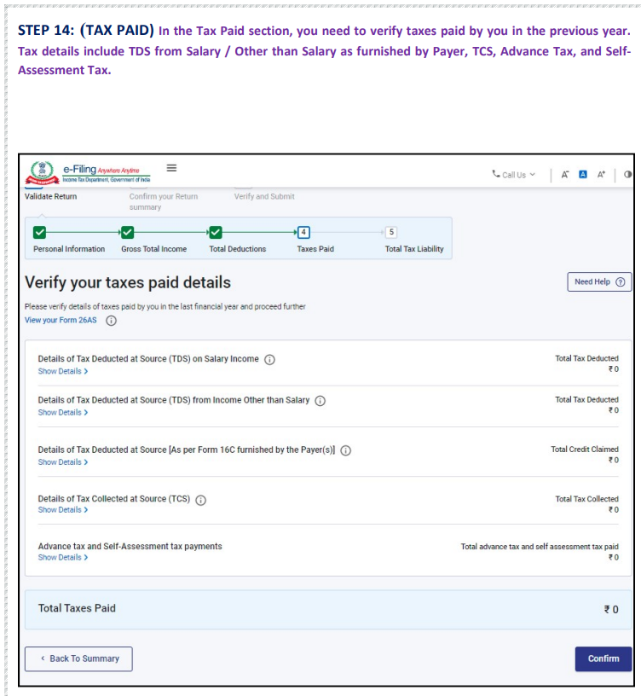

Slide 139
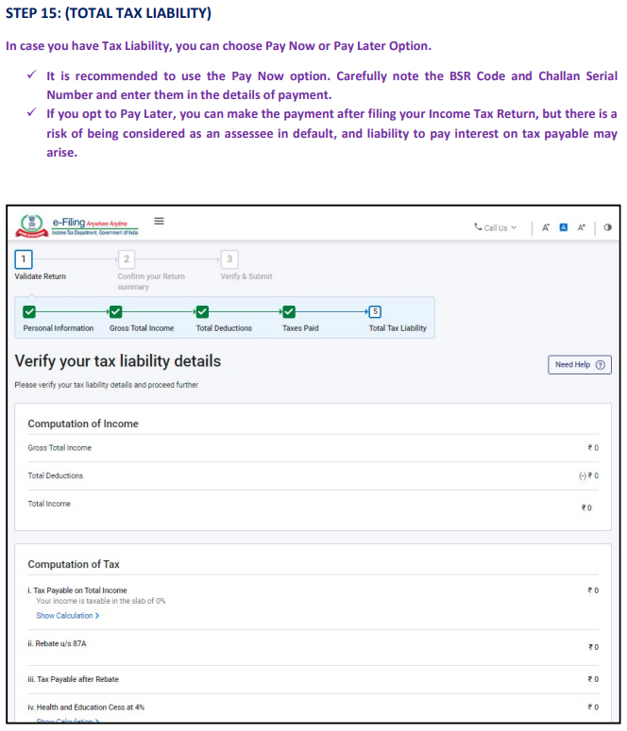

Slide 140
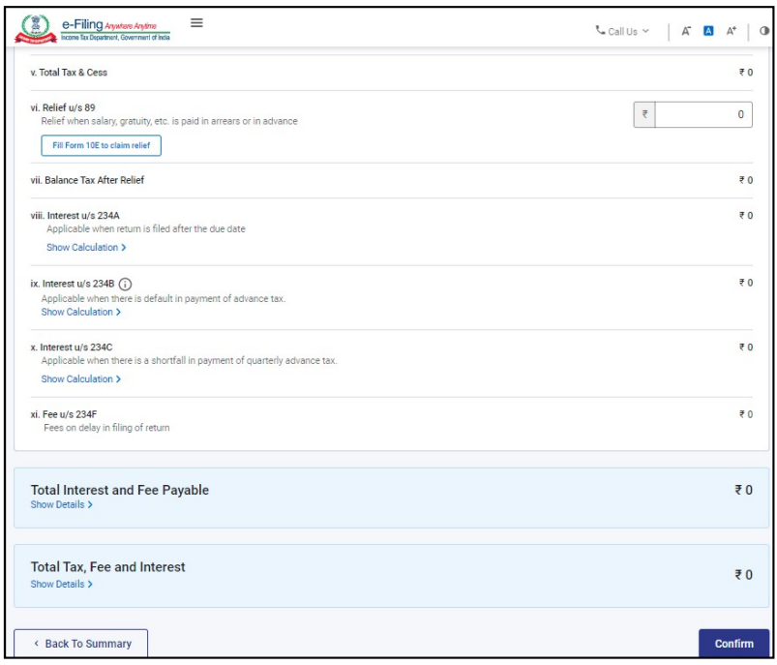

Slide 141
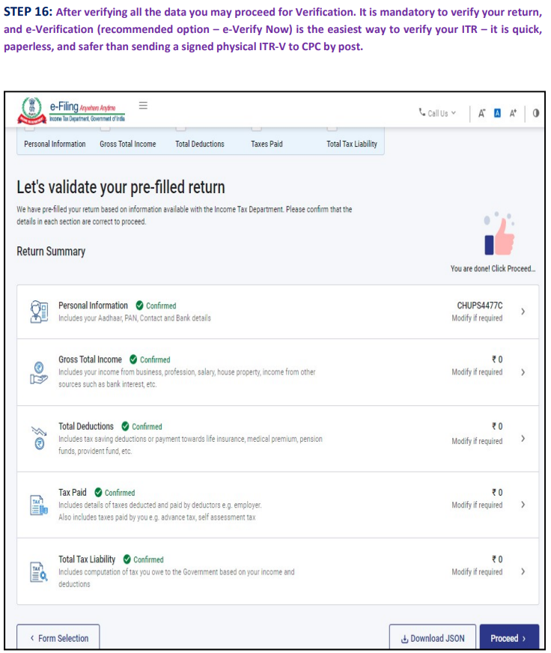

Slide 142
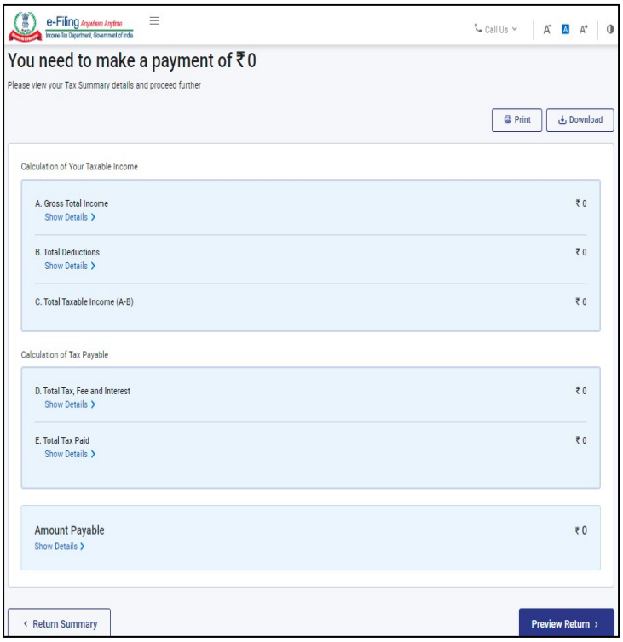

Slide 143
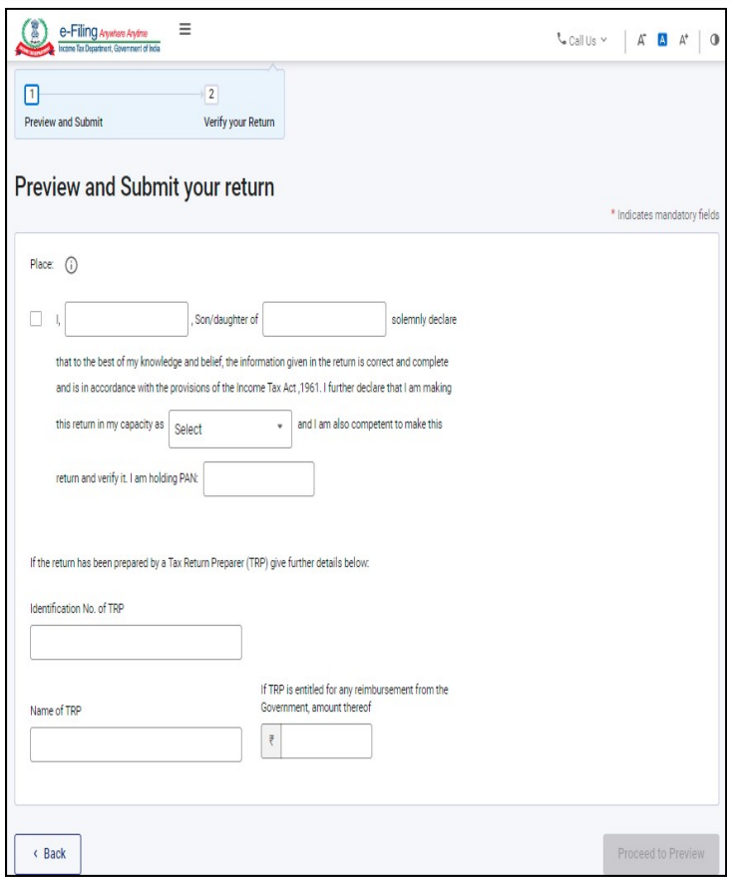

Slide 144
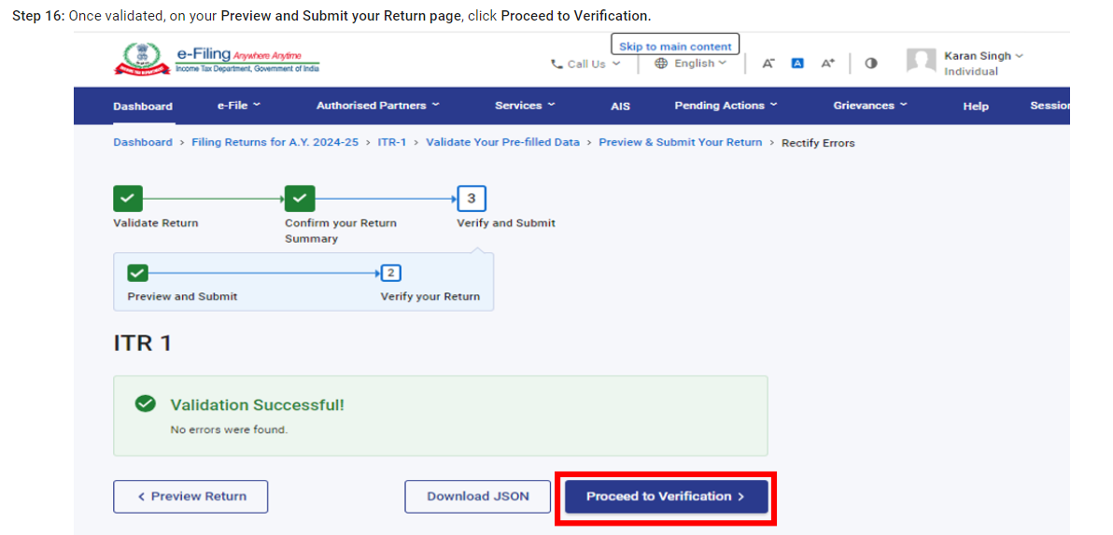

Slide 145
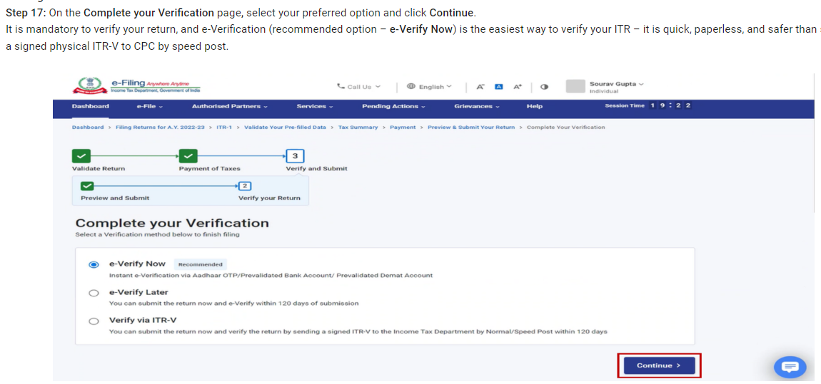

Slide 146
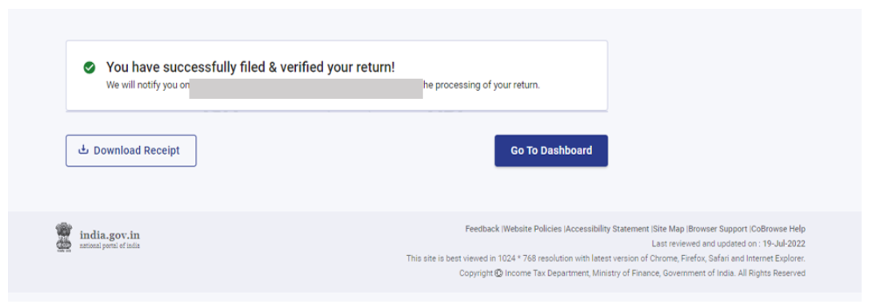

Slide 147
Clubbing Provisions
According to the stipulations of the Income Tax Act, a person has to pay taxes on all taxable income earned during a financial year.
At the time of computing the Gross Total Income, if the income of any other person in a family is included, then the inclusion is called ‘Clubbing of Income’.
Section 64 of the Income Tax Act, 1961 deals with clubbing of income. Clubbing of income ensures that taxpayers do not circumvent their tax liability by transferring their incomes and assets within the family.

Slide 148
Clubbing Provisions
As per the Income Tax Act, every person has to pay taxes on the taxable income earned. No person is allowed to divert his income to any relatives to reduce tax liability. Clubbing of income means an income of other person is included in the taxpayer’s total income while computing income tax payable.
Many taxpayers in India have attempted to reduce their income tax liability by transferring their incomes and assets to their family members, in such a way that most of the income falls under the taxable amount. The clubbing of income regulations ensures that such practices are curbed

Slide 149
Clubbing Provisions
Clubbing of income is needed under the following circumstance:
Investing money in the form of a fixed deposit in children name.
Earning assets in the name of relatives (wife or child).
Creating saving bank accounts for dependants.
Mutual funds for the child.
Shares in the name of spouse/child.
Post office savings for family members.
Also, if a taxpayer transfers the ownership of an asset and the income from the asset to a dependant, it will be continued to be added to the taxpayer’s income under the clubbing of income provisions.
Example: If a person is purchasing a flat in the name of a family member and the other person let out this flat on rent, the rental income earned by the person in name of the family member is taxable. As per section 64 of Income Tax, the income would be clubbed with person purchasing the flat.

Slide 150
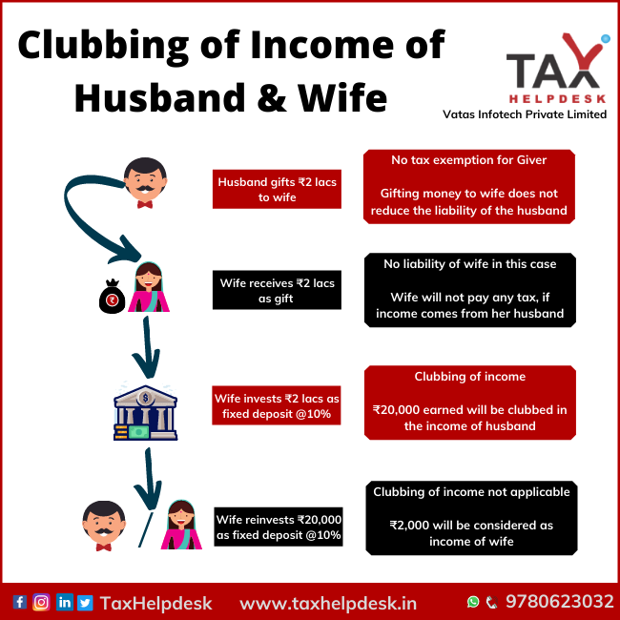

Slide 151
Set Off and Carry Forward of Losses
Profit and losses are two sides of a coin. Losses, of course, are hard to digest. However, the Income-tax law in India does provide taxpayers some benefits of incurring losses too. The law contains provisions for set-off and carry forward of losses.
Set off of losses
Set off of losses means adjusting the losses against the profit or income of that particular year. Losses that are not set off against income in the same year can be carried forward to the subsequent years for set off against income of those years. A set-off could be an intra-head set-off or an inter-head set-off.

Slide 152
Set Off and Carry Forward of Losses
Intra-head Set Off
The losses from one source of income can be set off against income from another source under the same head of income.
For eg: Loss from Business A can be set off against profit from Business B, where Business A is one source and Business B is another source and the common head of income is “Business”.
Exceptions to an intra-head set off:
Losses from a Speculative business will only be set off against the profit of the speculative business. One cannot adjust the losses of speculative business with the income from any other business or profession.
Loss from an activity of owning and maintaining race-horses will be set off only against the profit from an activity of owning and maintaining race-horses.
Long-term capital loss will only be adjusted towards long-term capital gains. However, a short-term capital loss can be set off against both long-term capital gains and short-term capital gain.
Losses from a specified business will be set off only against profit of specified businesses. But the losses from any other businesses or profession can be set off against profits from the specified businesses.

Slide 153
Set Off and Carry Forward of Losses
Inter-head Set Off
After the intra-head adjustments, the taxpayers can set off remaining losses against income from other heads.
Eg. Loss from house property can be set off against salary income.
Instances of an inter-head set off of losses:
Loss from House property can be set off against income under any head
Business loss other than speculative business can be set off against any head of income except income from salary.
One needs to also note that the following losses can’t be set off against any other head of income:
Speculative Business loss
Specified business loss
Capital Losses
Losses from an activity of owning and maintaining race-horses

Slide 154
Set Off and Carry Forward of Losses
Carry forward of losses
After making the appropriate and permissible intra-head and inter-head adjustments, there could still be unadjusted losses. These unadjusted losses can be carried forward to future years for adjustments against income of these years. The rules as regards carry forward differ slightly for different heads of income
Losses from House Property :
Can be carry forward up to next 8 assessment years from the assessment year in which the loss was incurred
Can be adjusted only against Income from house property
Can be carried forward even if the return of income for the loss year is belatedly filed.

Slide 155
Set Off and Carry Forward of Losses
Carry forward of losses
After making the appropriate and permissible intra-head and inter-head adjustments, there could still be unadjusted losses. These unadjusted losses can be carried forward to future years for adjustments against income of these years. The rules as regards carry forward differ slightly for different heads of income
Losses from Non-speculative Business (Regular Business) Loss
Can be carry forward up to next 8 assessment years from the assessment year in which the loss was incurred
Can be adjusted only against Income from business or profession
Not necessary to continue the business at the time of set off in future years
Cannot be carried forward if the return is not filed within the original due date.

Slide 156
Set Off and Carry Forward of Losses
Carry forward of losses
After making the appropriate and permissible intra-head and inter-head adjustments, there could still be unadjusted losses. These unadjusted losses can be carried forward to future years for adjustments against income of these years. The rules as regards carry forward differ slightly for different heads of income
Speculative Business Loss:
Can be carry forward up to next 4 assessment years from the assessment year in which the loss was incurred
Can be adjusted only against Income from speculative business
Cannot be carried forward if the return is not filed within the original due date.
Not necessary to continue the business at the time of set off in future years

Slide 157
Set Off and Carry Forward of Losses
Carry forward of losses
After making the appropriate and permissible intra-head and inter-head adjustments, there could still be unadjusted losses. These unadjusted losses can be carried forward to future years for adjustments against income of these years. The rules as regards carry forward differ slightly for different heads of income
Capital Losses:
Can be carry forward up to next 8 assessment years from the assessment year in which the loss was incurred
Long-term capital losses can be adjusted only against long-term capital gains.
Short-term capital losses can be set off against long-term capital gains as well as short-term capital gains
Cannot be carried forward if the return is not filed within the original due date

Slide 158
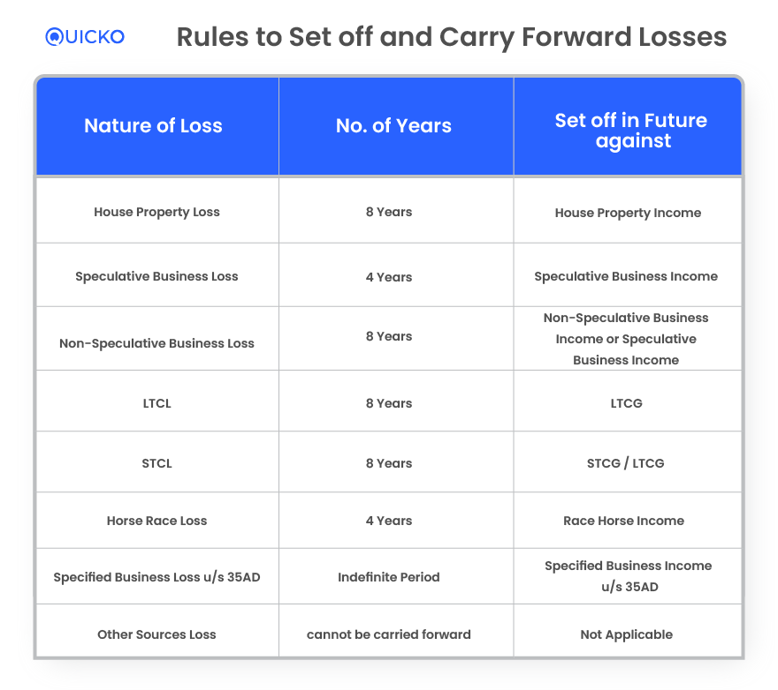

Slide 159
TDS (TAX DEDUCTED AT SOURCE)
The concept of TDS was introduced with an aim to collect tax from the very source of income. As per this concept, a person (deductor) who is liable to make payment of specified nature to any other person (deductee) shall deduct tax at source and remit the same into the account of the Central Government.
The deductee from whose income tax has been deducted at source would be entitled to get credit of the amount so deducted on the basis of Form 26AS or TDS certificate issued by the deductor.
Rates for deduct of tax at source
Taxes shall be deducted at the rates specified in the relevant provisions of the Act or the First Schedule to the Finance Act.
TDS Rates

Slide 160
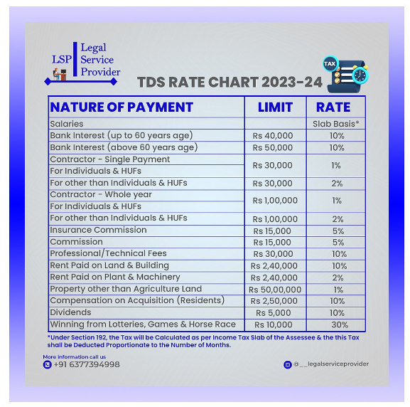

Slide 161
TDS (TAX DEDUCTED AT SOURCE)
How to pay Tax Deducted/Collected at source?
Tax deducted or collected at source shall be deposited to the credit of the Central Government by following modes:
1) Electronic mode (https://www.tin-nsdl.com): E-Payment is mandatory for
a) All corporate assesses; and
b) All assesses (other than company) to whom provisions of section 44AB of the Income Tax Act, 1961 are applicable.
2) Physical Mode: By furnishing the Challan 281 in the authorized bank branch
Due Date for Payment: TDS/TCS must be deposited by the 7th of the following month for monthly payments. For March, it’s April 30th.

Slide 162
TCS (TAX COLLECTION AT SOURCE)
Tax Collected at Source (TCS) is a tax payable by a seller which he collects from the buyer at the time of sale of goods. Section 206 of the Income Tax Act mentions the list of goods on which the seller should collect tax from buyers.
Who is a Seller for TCS?
A seller is categorized as any individual or organization authorized under Tax Collected at Source. The following are defined as Sellers –
1. Central Government 2. State Government
3. Statutory Corporation or Authority 4. Local Authority
5. Company 6. Co-operative Society
7. Partnership Firms 8. Any Individual or Hindu Undivided Family (HUF) defined under the Section 44AB, who has gross receipts or total sales that exceed the specified financial restricts based on the previous year
TCS

Slide 163
TCS (TAX COLLECTION AT SOURCE)
Tax Collected at Source (TCS) is a tax payable by a seller which he collects from the buyer at the time of sale of goods. Section 206 of the Income Tax Act mentions the list of goods on which the seller should collect tax from buyers.
Who is a Buyer for TCS?
A buyer is categorsied as any individual, who receives the actual goods or the rights of receiving goods at a tender, auction, sale, or other modes. All individuals (except for the below – mentioned list of individuals and organizations) are classified as buyers for TCS –
1. Public Sector Entities
2. Central Government
3. State Government
4. Consulates and any other Trade Representations of a Foreign Nation
5. High Commission Embassies
6. Clubs such as social clubs or sports clubs

Slide 164
TCS (TAX COLLECTION AT SOURCE)
What Goods & Transactions Covered under TCS Provisions?
The following goods and/or transactions are considered for Tax Collected at Source –
1. Liquors of alcoholic nature including IMFL (Indian Made Foreign Liquor) that are deemed for human consumption
2. Timber wood obtained from a leased forest area
3. Tendu Leaves
4. Timber wood obtained from any mode other than leased
5. Forest produces (other than timber and Tendu leaves)
6. Scrap
7. Parking lot tickets, Toll Plaza, Mining and Quarrying
8. Minerals that include iron ore, lignite or coal
9. Bullion having valuation over Rs. 2 lakh
10. Jewellery whose value exceeds Rs. Five lakhs
11. Motor vehicle purchases over Rs. 10 Lakhs

Slide 165
Advance Tax Administrative Procedures
Advance tax is the amount of income tax that is paid much in advance rather than a lump-sum payment at the year-end. Also known as earn tax, advance tax is to be paid in installments as per the due dates decided by the income tax department.
Why is advance tax important?
Advance tax is the income tax paid in advance for the income earned in a particular financial year. Usually, the tax is to be paid when the income is earned. Still, under the tax provisions of advance tax, the payer has to estimate the income for the entire year. And based on this estimate the tax is paid at specific time intervals. Here it is important that the tax payer estimates the income and then calculates the estimated tax on it to check whether he or she needs to pay the advance tax and how much.

Slide 166
Advance Tax Administrative Procedures
Who should pay advance tax?
As per section 208 of the Income Tax Act 1961, every person whose estimated tax liability for the year is more than or equal to `10,000 is liable to pay advance tax.
Those who are excluded from paying advance tax are senior citizens who are above the age of 60, not having any income from business or profession.
What are the important dates in advance tax?
Advance tax varies with the due dates. The advance tax to be paid by an individual, as well as corporate assessees, are as follows:
Sr | Due Date | Advance Tax Payable
1. | On or before 15th June | 15%
2. | On or before 15th September | 45%
3. | On or before 15th December | 75%
4. | On or before 15th March | 100%
Advance Tax

Slide 167
ICDS (Income Computation and Disclosure Standards):
Income Computation and Disclosure Standards (ICDS) are guidelines using which taxpayers and the Income Tax Department can calculate the taxable income obtained by an assessee in a financial year.
The ICDS were framed by the Government of India with the objective of inculcating uniformity in accounting policies.
The purpose of the ICDS is to govern the computation of income in accordance with the pertinent tax provisions. ICDS has been framed using Generally Accepted Accounting Principles (GAAPs ) with the assistance of the Institute of Chartered Accountants of India (ICAI). It has been in existence from the financial year of 2015-16. In this article, we discuss the various provisions of ICDS.

Slide 168
Features of ICDS
ICDS is not meant for maintenance of books of account, but for the computation of income.
Non-compliance to the standards may place the authority in a position of assessing the income on ‘best judgment’ basis.
ICDS doesn’t have any criterion of income or turnover.
Every ICDS, except on securities, provide for transitional provisions to facilitate first-time adoption and consideration of the resultant impact.
In the event of a conflict between the provisions of the Act and ICDS, the provisions of the Act will be given preference ahead of the latter.
ICDS does not have prudence as a fundamental assumption except if it is specifically stated so in the respective ICDS. It may lead to earlier recognition of income or gains or later recognition of expenses in comparison with the Accounts formulated under the existing Accounting Standards (AS).
The Income Tax Act allows the Assessing Officer to conduct an assessment in accordance with Section 144 on the event of a failure to compute income according to ICDS.
Form 3CD has been revised for making mandatory disclosures in compliance with ICDS.

Slide 169
Numericals

Slide 170

Question 1) A salaried individual's annual income (from salary only) increases from ₹12, 50, 000 to ₹13,50, 000. Calculate the total income tax payable under the FY 2024-25/assessment year 2025-26 considering new income tax regime in both the cases. Comment on the marginal relief.

Slide 171
Case 1: When income = ₹12, 50, 000
1. Gross salary = ₹12,50,000
2. Standard deduction = ₹75,000
⇒ Taxable income = 12,50,000 − 75,000 = ₹11,75,000
3. Since ₹11,75,000 ≤ ₹12,75,000
he qualifies for full rebate under Section 87A, so tax = 0
So at ₹12, 50, 000 income, the total tax under new regime = ₹0.

Slide 172
Case 2: When income = ₹13, 50, 000
1. Gross salary = ₹13,50,000
2. Standard deduction = ₹75,000
⇒ Taxable income = 13,50,000 − 75,000 = ₹12,75,000
3. Now taxable income exceeds ₹12,00,000, so rebate is not fully available
4. Compute tax as per slabs:
o On first ₹4,00,000 → 0% = ₹0
o On next ₹4,00,000 (i.e. from ₹4,00,001 to ₹8,00,000) → 5% of ₹4,00,000 = ₹20,000
o On next ₹4,00,000 (i.e. ₹8,00,001 to ₹12,00,000) → 10% of ₹4,00,000 = ₹40,000
o On the remaining above ₹12,00,000 up to ₹12,75,000 → (₹12,75,000 − ₹12,00,000) = ₹75,000 taxed at 15% = ₹11,250
So total tax before cess = 20,000 + 40,000 + 11,250 = ₹71,250
5. Health & Education cess at 4% on ₹71,250 = 0.04 × 71,250 = ₹2,850
6. Total tax liability = 71,250 + 2,850 = ₹74,100
Therefore:
• When income is ₹12,50,000 → Total tax = ₹0 (under new regime)
• When income is ₹13,50,000 → Total tax = ₹74,100
Marginal relief ensures that the increase in tax payable does not exceed the increase in income when your income crosses the rebate threshold limit.

Slide 173
Check for marginal relief
Now, check if the excess tax exceeds the excess income (over ₹12.75 lakhs):
• Excess income = ₹75,000
• Excess tax = ₹74,100 − ₹0 (since at ₹12 lakh tax = 0) = ₹74,100
Here, excess tax (₹74,100) is slightly less than excess income (₹75,000).
Hence, marginal relief is not applicable.

Slide 174
Question 2) A salaried individual's annual income (from salary only) increases from ₹49,50,000 to ₹51,50,000. Calculate the total income tax payable under the FY 2024-25/assessment year 2025-26 considering new income tax regime in both the cases. Also comment on marginal stability and surcharge.
Solution:
Taxable income
1. Old income: ₹49,50,000
o Standard deduction: ₹75,000
o Taxable income = 49,50,000 − 75,000 = 48,75,000
2. New income: ₹51,50,000
o Standard deduction: ₹75,000
o Taxable income = 51,50,000 − 75,000 = 50,75,000

Slide 175
Compute tax on old income (₹48,75,000)
Slab-wise tax:
Slab (₹) | Rate | Tax (₹)
0–4,00,000 | 0% | 0
4,00,001–8,00,000 | 5% | 20,000
8,00,001–12,00,000 | 10% | 40,000
12,00,001–16,00,000 | 15% | 60,000
16,00,001–20,00,000 | 20% | 80,000
20,00,001–24,00,000 | 25% | 1,00,000
24,00,001–48,75,000 | 30% | 24,75,000 × 30% = 7,42,500
Subtotal Tax = 0 + 20,000 + 40,000 + 60,000 + 80,000 + 1,00,000 + 7,42,500 = ₹9,42,500
2. Surcharge: Income < 50,00,001 → No surcharge
3. Cess: 4% × 9,42,500 ≈ ₹37,700
Total Tax on ₹48,75,000 = 9,42,500 + 37,700 ≈ ₹9,80,200

Slide 176
Compute tax on old income (₹50,75,000) Slab-wise tax
Slab (₹) | Rate | Tax (₹)
0–4,00,000 | 0% | 0
4,00,001–8,00,000 | 5% | 20,000
8,00,001–12,00,000 | 10% | 40,000
12,00,001–16,00,000 | 15% | 60,000
16,00,001–20,00,000 | 20% | 80,000
20,00,001–24,00,000 | 25% | 1,00,000
24,00,001–50,75,000 | 30% | 26,75,000 × 30% = 8,02,500
Subtotal Tax = 0 + 20,000 + 40,000 + 60,000 + 80,000 + 1,00,000 + 8,02,500= ₹10,02,500
1. Surcharge: Surcharge: Income > 50,00,000 → 10%
• 10% × 10,02,500 = ₹1,00,250
2. Tax after surcharge = 10,02,500 + 1,00,250 = 11,02,750
3. Cess: 4% × 11,02,750 ≈ ₹44,110
Total Tax on ₹50,75,000 = 11,02,750 + 44,110 ≈ ₹11,46,860
Tax increase due to ₹2,00,000 income rise = 11,46,860−9,80,200=1,66,660
• Additional income = ₹2,00,000
Since increase in tax is less than additional income, no marginal relief will be given.

